Slide 1
Concern For Lost Souls

Slide 2
1. We Have A Responsibility
Ezekiel 33:2-9
Acts 18:5-6
Romans 10:13-17

Slide 3
2. The Lord’s Concern For Lost Souls
1 Timothy 1:15
Luke 19:10
Luke 15:4-7

Slide 4
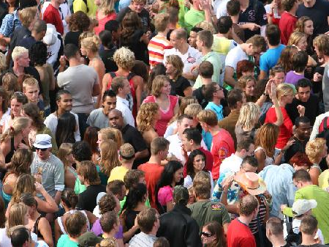
2. The Lord’s Concern For Lost Souls
1 Timothy 1:15
Luke 19:10
Luke 15:4-7
Matthew 9:35-38

Slide 5
3. Our Concern For Lost Souls
2 Corinthians 4:7
“treasure in earthen vessels”
2 Kings 7:3-10

Slide 6
4. Concern For Our Own Soul
Ezekiel 33:7-9

