Slide 1
Time To Stop Praying

Slide 2
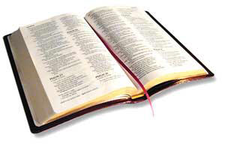
“pray without ceasing”
1 Thessalonians 5:17

Slide 3
“Ask, and it will be given to you; seek, and you will find; knock, and it will be opened to you. For everyone who asks receives, and he who seeks finds, and to him who knocks it will be opened.”
Matthew 7:7-8

Slide 4
“Then He spoke a parable to them, that men always ought to pray and not lose heart.”
Luke 18:1

Slide 5
1. Alien Sinners Need To Stop Praying For Salvation
Acts 9:8-11, 22:16
Acts 10:1-6

Slide 6
2. Rebellious Sinners Need To Stop Praying
John 9:31
Psalm 66:18
Proverbs 15:29, 28:9

Slide 7
3. Those Who Are Mistreating Family Members Need To Stop Praying
1 Peter 3:7
Eph. 5:25
Eph. 5:22-24, 33; 6:1-4

Slide 8
4. Unforgiving Christians Need To Stop Praying For Forgiveness
Matthew 6:12, 14-15
Mark 11:25-26
Matthew 5:7

Slide 9
5. Hypocrites Need To Stop Praying
Matthew 6:5-6

Slide 10
“For the eyes of the Lord are on the righteous, and His ears are open to their prayers; but the face of the Lord is against those who do evil.”
1 Peter 3:12

