Slide 1
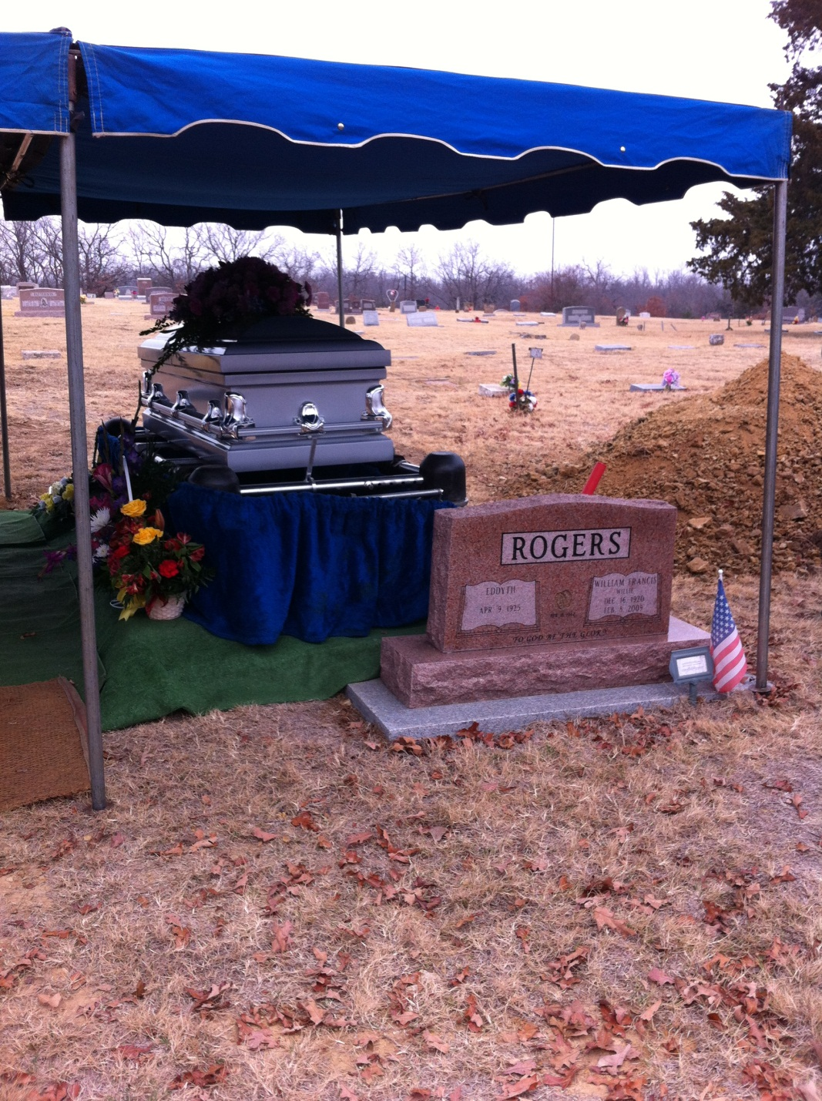
Coping With the Loss of a Loved One

Slide 2
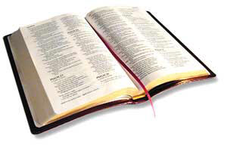
Death is the common experience of all mankind.
“Now the days of David drew near that he should die, and he charged Solomon his son, saying: ‘I go the way of all the earth…’”
1 Kings 2:1-2

Slide 3
How To Cope With Loss
Mourn Their Loss
Seek Comfort From God
Accept Comfort From Others
Be Grateful
Go On With Life
Cherish the Memories

Slide 4
The Death of a Non-Christian
We did what we could
Trust in God as a righteous judge - Gen. 18:25
Use this death as motivation to save the lost – Luke 16:27-31

Slide 5
How a Congregation Copes With the Loss of a Member
Stephen – Acts 6-8
James – Acts 12:1-5

Slide 6
How a Congregation Copes With the Loss of a Member
Mourned Their Loss – Acts 8:2
Gathered Together – Acts 12:1-5, 12 1 Cor. 12:26; Rom. 12:15
Continued the Work – Acts 8:4 2 Tim. 2:2; Titus 2:3-5; 2 Kings 2:8-14

