Slide 1
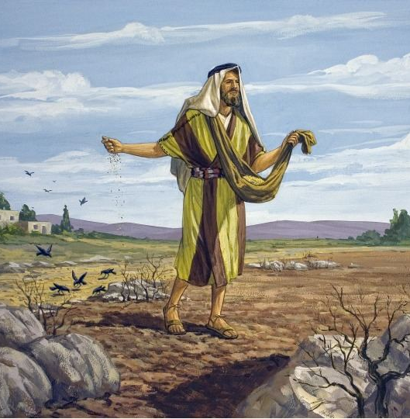
The Parable of the Soils
Matthew 13
Mark 4
Luke 8

Slide 2
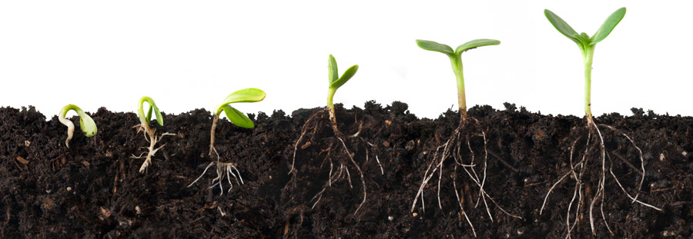
The Different Soils
Wayside Heart
Stony Heart
Thorny Heart
Good Heart

Slide 3
Emphasis Upon Hearing the Word of God
Parable begins with, “Listen!” (Mark 4:3)
Ends with Jesus crying out, “He who has ears to hear, let him hear!”
In the explanation, Jesus says the soils represent the ones who “hear the word.”
“Therefore take heed how you hear” (Luke 8:18).

Slide 4
Cultivating the Ground/Changing the Heart
Wayside Heart: broken up - Hosea 10:12
Stony Heart: count the cost - Luke 14:25-33
Thorny Heart: priorities - Matt. 6:33, 16:24
Good Heart: can become hard - Heb. 3:12-13

Slide 5
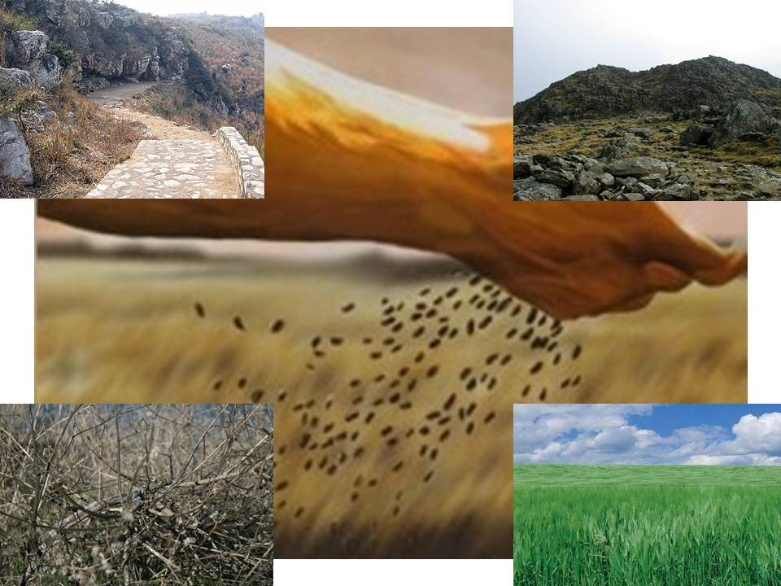
What kind of soil are you?

