Slide 1
SILENCE Evidence of the Inspiration of the Bible

Slide 2
Traditional Arguments for Biblical Inspiration
Unity of the Bible
Fulfilled Prophecies
Historical, Geographical, Scientific Accuracy
Impartiality

Slide 3
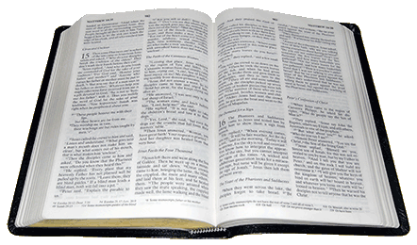
The Bible is Silent About…
The Origin of God
Description of God or Christ
Fate of Noah’s Ark and the Ark of the Covenant
“Missing Years” of the Life of Christ
Joseph
Mary
? ? ?

Slide 4
The Bible is Silent About…
The Mysterious Events Surrounding the Crucifixion of Jesus
The Apostles
Background of Luke the Physician
? ? ?

Slide 5
We can have confidence that the Bible is inspired by God and is an accurate revelation of the mind of God to mankind.
Deuteronomy 29:29

