Slide 1
Putting the Preacher in His Place
First Corinthians 3-4

Slide 2
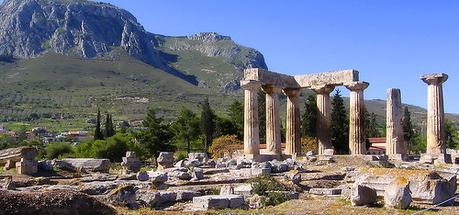
In ancient Corinth, orators were admired like movie stars.
1 Cor. 1:11-13

Slide 3
The Preacher is a…
Servant or Minister - 1 Cor. 3:5

Slide 4
The Preacher is a…
Servant or Minister - 1 Cor. 3:5
Farmer or Gardener - 1 Cor. 3:6-8

Slide 5
The Preacher is a…
Servant or Minister - 1 Cor. 3:5
Farmer or Gardener - 1 Cor. 3:6-8
Builder - 1 Cor. 3:9-15

Slide 6
The Preacher is a…
Servant or Minister - 1 Cor. 3:5
Farmer or Gardener - 1 Cor. 3:6-8
Builder - 1 Cor. 3:9-15
Servant (Under Rower) - 1 Cor. 4:1

Slide 7
The Preacher is a…
Servant or Minister - 1 Cor. 3:5
Farmer or Gardener - 1 Cor. 3:6-8
Builder - 1 Cor. 3:9-15
Servant (Under Rower) - 1 Cor. 4:1
Steward - 1 Cor. 4:1-5

Slide 8
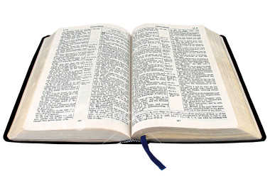
The Preacher is a…
Servant or Minister - 1 Cor. 3:5
Farmer or Gardener - 1 Cor. 3:6-8
Builder - 1 Cor. 3:9-15
Servant (Under Rower) - 1 Cor. 4:1
Steward - 1 Cor. 4:1-5

