Slide 1
How Should We Live Our Life Upon This Earth?

Slide 2
Book of Ecclesiastes
What is the purpose of man’s life upon this earth?
What can provide contentment in this world and true satisfaction in the life to come?
What should man do with his talents and abilities?
What heritage shall we leave our children?

Slide 3
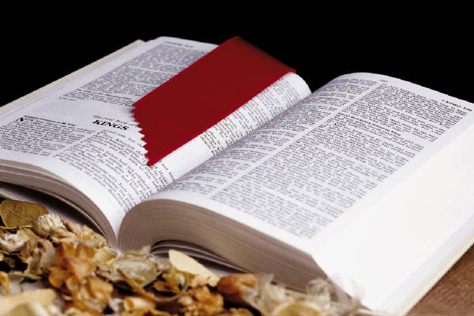
What advantage does man have in all his work which he does under the sun? (Ecclesiastes 1:3 NASB)

Slide 4
Book of Ecclesiastes
The purpose of the Book of Ecclesiastes is to convince men of the uselessness of any world view which does not rise above the horizon of man himself.
The Book of Ecclesiastes seeks to teach mankind the correct relationship to this earthly life.

Slide 5
Book of Ecclesiastes
The design of the Book of Ecclesiastes is to show that happiness is to be had only in the fear of God and obedience to his laws, which alone can give man a cheerful enjoyment of his present life upon this earth, and an assurance of his everlasting happiness in eternity.

Slide 6
All my eyes desired I did not refuse them. I did not withhold my heart from any pleasure, for my heart was pleased because of all my labor and this was my reward for all my labor. Thus I considered all my activities which my hands had done and the labor which I had exerted, and behold all was vanity and striving after wind and there was no profit under the sun. (Ecclesiastes 2:9-11 NASB)

Slide 7
What Is Man’s Purpose Upon This Earth?
Earthly Wisdom
Earthly Pleasure
Earthly Possessions
Human Labor

Slide 8
Certainties of Life
God
Creator
Controller
Sustainer

Slide 9
There is nothing better for a man than to eat and drink and tell himself that his labor is good. This also I have seen, that it is from the hand of God. For who can eat and who can have enjoyment without Him? For to a person who is good in His sight He has given wisdom and knowledge and joy, while to the sinner He has given the task of gathering and collecting so that he may give to one who is good in God's sight. (Ecclesiastes 2:24-26)

Slide 10
There is an appointed time for everything. And there is a time for every event under heaven (Ecclesiastes 3:1 NASB)

Slide 11
He has made everything appropriate in its time. He has also set eternity in their heart (Ecclesiastes 3:11 NASB)

Slide 12
I know that there is nothing better for them than to rejoice and to do good in one's lifetime; moreover, that every man who eats and drinks sees good in all his labor--it is the gift of God. I know that everything God does will remain forever; there is nothing to add to it and there is nothing to take from it, for God has so worked that men should fear Him. (Ecclesiastes 3:12-14 NASB)

Slide 13
Certainties of Life
God
Death

Slide 14
For the living know they will die; but the dead do not know anything, nor have they any longer a reward, for their memory is forgotten. Indeed their love, their hate, and their zeal have already perished, and they will no longer have a share in all that is done under the sun. (Ecclesiastes 9:5-6 NASB)

Slide 15
Certainties of Life
God
Death
Judgment

Slide 16
I have seen under the sun that in the place of justice there is wickedness, and in the place of righteousness there is wickedness. I said to myself, "God will judge both the righteous man and the wicked man," for a time for every matter and for every deed is there. (Ecclesiastes 3:16-17)

Slide 17
How To Live My Life
Enjoy Life

Slide 18
Go then, eat your bread in happiness, and drink your grape juice with a cheerful heart; for God has already approved your works. (Ecclesiastes 9:7 NASB)

Slide 19
How To Live My Life
Enjoy Life
Be Positive

Slide 20
Let your clothes be white all the time, and let not oil be lacking on your head. (Ecclesiastes 9:8 NASB)

Slide 21
How To Live My Life
Enjoy Life
Be Positive
Enjoy Family

Slide 22
Enjoy life with the woman whom you love all the days of your fleeting life which He has given to you under the sun; for this is your reward in life, and in your toil in which you have labored under the sun. (Ecclesiastes 9:9 NASB)

Slide 23
How To Live My Life
Enjoy Life
Be Positive
Enjoy Family
Do Your Best

Slide 24
Whatever your hand finds to do, verily, do it with all your might; for there is no activity or planning or knowledge or wisdom in Sheol where you are going. (Ecclesiastes 9:10 NASB)

Slide 25
How To Live My Life
Enjoy Life
Be Positive
Enjoy Family
Do Your Best
Serve God

Slide 26
The conclusion, when all has been heard, is: fear God and keep His commandments, because this applies to every person. For God will bring every act to judgment, everything which is hidden, whether it is good or evil. (Ecclesiastes 12:13-14 NASB)

Slide 27
Fear God
Reverence at the thought of
God’s infinite majesty,
holiness, and justice;
Gratitude for his loving-
kindness and tender mercy;
Confidence in his wisdom,
power, and faithfulness;
Submission to his will.

Slide 28
How Should Mankind Live While Upon This Earth?
Fear God
Keep His Commandments
Where God is honored and his will cheerfully performed, there the whole duty of man is fulfilled.

Slide 29
How To Live My Life
Enjoy Life
Be Positive
Enjoy Family
Do Your Best
Serve God

