Slide 1
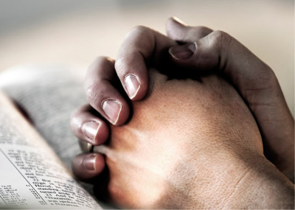
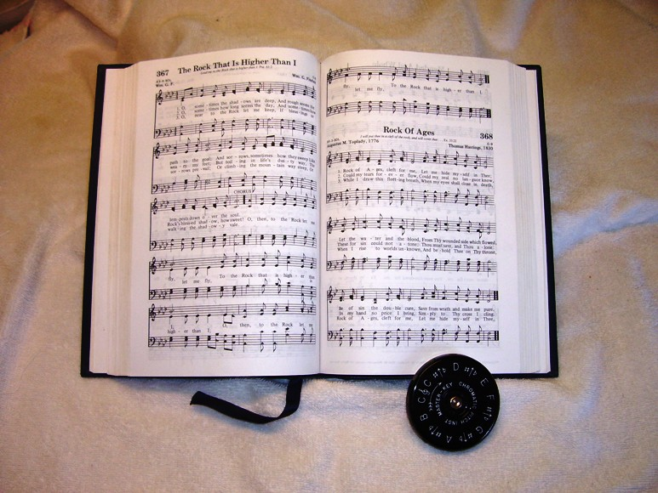
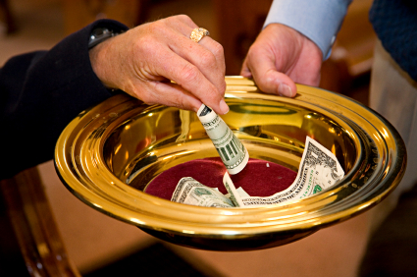
Reverencing God in Our Worship

Slide 3
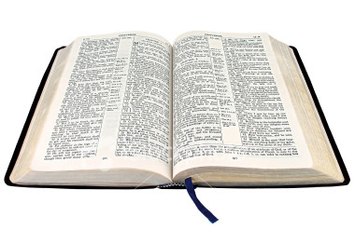
“God is greatly to be feared in the assembly of the saints, and to be held in reverence by all those around Him.”
Psalm 89:7
vs.

Slide 4
“Therefore, since we are receiving a kingdom which cannot be shaken, let us have grace, by which we may serve God acceptably with reverence and godly fear. For our God is a consuming fire.”
Hebrews 12:28-29
vs.

Slide 5
How To Reverence God in Worship
1. Remember
Remember what we are coming here to do.
Remember who God is.
Rev. 4; Ex. 19:16-19; Ezek. 1:26-28
Remember why God is worthy of our worship.
Psalm 29:1-2; 100; 95:6-7

Slide 6
How To Reverence God in Worship
2. Attitude
Heart - Matthew 15:8
Humility - Luke 18:10-14
Respect - Isaiah 66:2; Nehemiah 8:5-6

Slide 7
How To Reverence God in Worship
3. Dress
“God sees my heart. He doesn’t care how I am dressed” - 1 Peter 3:3-4
It does matter how we dress for certain situations - Gen. 41:14
The way we dress reflects that which is in our heart.

Slide 8
How To Reverence God in Worship
4. Conduct
Worship is to be conducted decently and in order - 1 Cor. 14:40
Be on time.
Don’t cause distractions.
Silence your cell phone, don’t send text messages
Stay seated

Slide 9
How To Reverence God in Worship
5. Participation
We must participate.
We must do our best.
Be serious as we worship.

Slide 10
How Can I Reverence God in Worship?
Remember
Attitude
Dress
Conduct
Participation
“Therefore, since we are receiving a kingdom which cannot be shaken, let us have grace, by which we may serve God acceptably with reverence and godly fear.”
Hebrews 12:28

