Slide 1

“Let There Be Light”

Slide 2
Physical Qualities of Light
Rulership Over Universe - Gen. 1:16
Protection and Safety - Ex. 13:21
Illumination - Acts 16:29
Source of Life

Slide 3
“Light is one of the most astonishing productions of the creative skill and power of God. It is the grand medium by which all his other works are discovered, examined, and understood, so far as they can be known. Its immense diffusion and extreme velocity are alone sufficient to demonstrate the being and wisdom of God” (Adam Clarke).

Slide 4
Light Describes Spiritual Illumination
Psalm 119:105
Psalm 119:130
2 Peter 1:19
Daniel 5:14

Slide 5
God is the Source of Light
God is Light - 1 John 1:5
Dwells in Unapproachable Light - 1 Tim. 6:16
Father of Lights - James 1:17
Creation of Light Was His First Command - Genesis 1:3

Slide 6
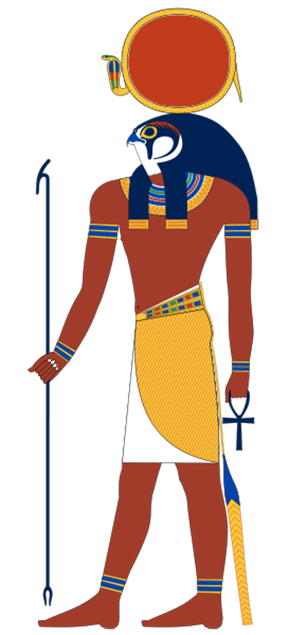
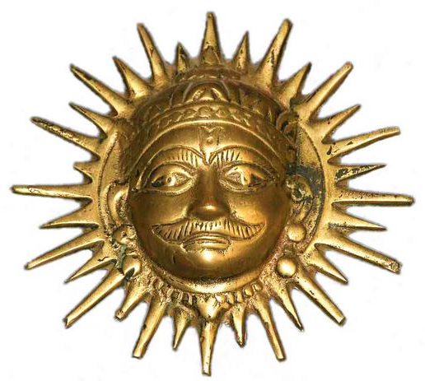
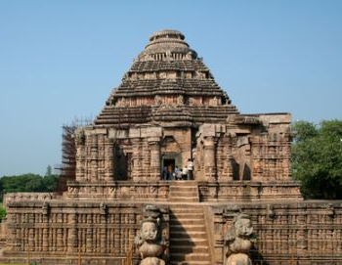
Pagans worship light.
We worship the God who created Light!

Slide 7
1. Introduction of Light at Creation
Genesis 1:3
The command was with a purpose, to dispel the darkness (v. 2).
The command resulted in that which was “good.”
The command gave order to God’s creation.

Slide 8
2. Introduction of Light at the Incarnation of Jesus
Matthew calls the Incarnate Christ “Jesus” and “Immanuel” (Matt. 1:21, 23).
John calls Him “the Light” (John 1:4-9).
Isaiah 9:2; Matthew 4:12-17

Slide 9
2. Introduction of Light at the Incarnation of Jesus
Jesus declared Himself to be the light of the world (John 8:12).
We are to walk in the light so that darkness will not overtake us (John 12:35).
Jesus came as a light in the world to give us a way out of darkness (John 12:46).

Slide 10
3. Introduction of Light at Our Conversion
2 Corinthians 4:3-6

Slide 11
3. Introduction of Light at Our Conversion
1 Peter 2:9 - the gospel calls us out of darkness and into light.
Acts 26:18 - Paul was commissioned by Christ to go to the Gentiles to open their eyes, in order to “turn them from darkness to light…”
1 John 1:7 - fellowship with God is dependent upon us continuing to walk in the light of God’s word.

Slide 12
“Let There Be Light”
God has given us light.
Physical light at the Creation.
His Son at the Incarnation.
Spiritual Light at Our Conversion.

