Slide 1

Dangers Facing the Church Today

Slide 2
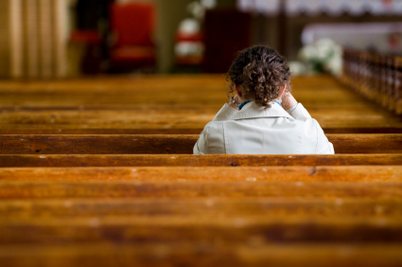
The Role of Women in the Church

Slide 3
Universal Roles of Headship and Submission

Slide 4
Universal Roles of Headship and Submission
“But I want you to know that the head of every man is Christ, the head of woman is man, and the head of Christ is God.”
1 Corinthians 11:3
God
⇧
Christ
⇧
Man
⇧
Woman

Slide 5

Submit
“To yield to the action, power or control of another or others, to defer to another’s judgment or decision. Voluntarily subjecting oneself to the will of another, the willingness to affirm the leadership of another.”

Slide 6
Organization of Local Church
Elders and Deacons - Philippians 1:1
Qualifications: 1 Timothy 3:1-13, Titus 1:5-9
  Elder: man, husband, father
  Deacon: husband, father
It is impossible for a woman to qualify to serve as an elder or a deacon.

Slide 7
Worship in the Church

Slide 8
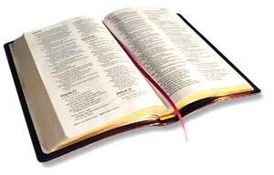
Worship in the Church
11. Let a woman learn in silence with all submission.
12. And I do not permit a woman to teach or to have authority over a man, but to be in silence.
1 Timothy 2:11-12

Slide 9
Worship in the Church
11. Let a woman learn in silence with all submission.
12. And I do not permit a woman to teach or to have authority over a man, but to be in silence.
1 Timothy 2:11-12

Slide 10
Worship in the Church
11. Let a woman learn in silence with all submission.
12. And I do not permit a woman to teach or to have authority over a man, but to be in silence.
1 Timothy 2:11-12

Slide 11
Worship in the Church
11. Let a woman learn in silence with all submission.
12. And I do not permit a woman to teach or to have authority over a man, but to be in silence.
1 Timothy 2:11-12

Slide 12
Basis For These Restrictions
Not time and culture!
The order of creation (v. 13)
Consequences of woman’s involvement in the first sin (v. 14; Gen. 3:16)
Women (and men) will find their salvation by abiding within the roles given to them by God (v. 15)

Slide 13
Worship in the Church
34 Let your women keep silent in the churches, for they are not permitted to speak; but they are to be submissive, as the law also says.
35 And if they want to learn something, let them ask their own husbands at home; for it is shameful for women to speak in church.
1 Corinthians 14:34-35

Slide 14
Worship in the Church
34 Let your women keep silent in the churches, for they are not permitted to speak; but they are to be submissive, as the law also says.
35 And if they want to learn something, let them ask their own husbands at home; for it is shameful for women to speak in church.
1 Corinthians 14:34-35

Slide 15
Worship in the Church
34 Let your women keep silent in the churches, for they are not permitted to speak; but they are to be submissive, as the law also says.
35 And if they want to learn something, let them ask their own husbands at home; for it is shameful for women to speak in church.
1 Corinthians 14:34-35

Slide 16
Worship in the Church
34 Let your women keep silent in the churches, for they are not permitted to speak; but they are to be submissive, as the law also says.
35 And if they want to learn something, let them ask their own husbands at home; for it is shameful for women to speak in church.
1 Corinthians 14:34-35

Slide 17
Worship in the Church
34 Let your women keep silent in the churches, for they are not permitted to speak; but they are to be submissive, as the law also says.
35 And if they want to learn something, let them ask their own husbands at home; for it is shameful for women to speak in church.
1 Corinthians 14:34-35

Slide 18
Argument Against Distinctions Based On Gender
“There is neither Jew nor Greek, there is neither slave nor free, there is neither male nor female; for you are all one in Christ Jesus.”
Galatians 3:28

Slide 19

What Women Can Do in the Local Church

Slide 20
What Women Can Do in the Local Church
Serve the Church
Prepare communion
Clean building
Suggest or make improvements to the appearance of the building
Fold bulletins, mail fliers

Slide 21
What Women Can Do in the Local Church
Serve the Church
Faithful attendance
Engage heartily in worship
Greet visitors, get to know others
Encourage others
Pray for the brethren
Love all the brethren in deed and in truth

Slide 22
What Women Can Do in the Local Church
Serve Individuals
Visit sick and shut-ins
Prepare food for others
Have members in home
Send cards/make calls to encourage
Make things for others (Dorcas)
Give people rides

Slide 23
What Women Can Do in the Local Church
Role as a Teacher
Set good example for others
Mentor younger women (Titus 2:3-5)
Teach children’s or women’s classes, help a teacher, prepare Bible class material
Invite people to services
Teach others the gospel
Host a Bible study in your home

Slide 24
What Women Can Do in the Local Church
Role as a Wife and Mother
Help husband qualify to serve as an elder or deacon (1 Tim. 3:11)
Encourage husband or sons who are leading in the worship to do their best
Raise godly children (2 Tim. 1:5)

