Slide 2
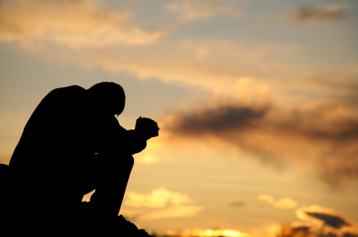
Paul’s Prayer For the Colossians
Colossians 1:9-14

Slide 3
Paul Prayed for Churches
He had a deep concern for all the churches (2 Cor. 11:28)
Ephesians 1:16, 3:14-21
Philippians 1:4
Colossians 1:3, 9
1 Thessalonians 1:2
2 Thessalonians 1:11
2 Timothy 1:3; Philemon 4

Slide 4
1. Filled With Knowledge of God’s Will
“to ask that you may be filled with the knowledge of His will…” (v. 9)
“stand perfect and complete in all the will of God” (Col. 4:12)

Slide 5
1. Filled With Knowledge of God’s Will
Wisdom - James 1:5
Spiritual Understanding - Heb. 5:12-14

Slide 6
2. Walk Worthy of the Lord
“beseech you to walk worthy of the calling with which you were called” (Eph. 4:1).
“Only let your conduct be worthy of the gospel of Christ…” (Phil. 1:27).
We have been bought at a price (1 Cor. 6:20).

Slide 7
What does the “worthy walk” consist of?
Being Fruitful in Every Good Work
Increasing in the Knowledge of God
Being Strengthened With All Might
Giving Thanks to the Father

Slide 8
Paul’s Prayer for the Colossians
Be filled with the knowledge of God’s will.
Walk worthy of the Lord.
Being Fruitful in Every Good Work
Increasing in the Knowledge of God
Being Strengthened With All Might
Giving Thanks to the Father

Slide 9
God’s Will For Us
Be filled with the knowledge of God’s will.
Walk worthy of the Lord.
Being Fruitful in Every Good Work
Increasing in the Knowledge of God
Being Strengthened With All Might
Giving Thanks to the Father

