Slide 1
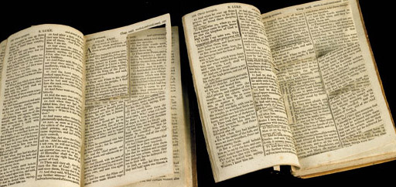
Penknife Religion
Jeremiah 36:20-24

Slide 2
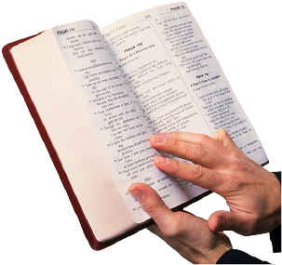
One True Church
“And I also say to you that you are Peter, and on this rock I will build My church, and the gates of Hades shall not prevail against it.”
Matthew 16:18

Slide 3
Baptism For Salvation
“Repent, and let every one of you be baptized in the name of Jesus Christ for the remission of sins…”
Acts 2:38

Slide 4
Baptism For Salvation
“Repent, and let every one of you be baptized in the name of Jesus Christ for the remission of sins…”
Acts 2:38
“He who believes and is baptized will be saved…”
Mark 16:16

Slide 5
Once Saved, Always Saved
“You have become estranged from Christ, you who attempt to be justified by law; you have fallen from grace.”
Galatians 5:4

Slide 6
Attendance
“And let us consider one another in order to stir up love and good works, not forsaking the assembling of ourselves together, as is the manner of some, but exhorting one another, and so much the more as you see the Day approaching.”
Hebrews 10:25

Slide 7
Modest Apparel
“In like manner also, that the women adorn themselves in modest apparel, with propriety and moderation, not with braided hair or gold or pearls or costly clothing, but, which is proper for women professing godliness, with good works.”
1 Timothy 2:9-10

Slide 8
Language
“Let no corrupt word proceed out of your mouth, but what is good for necessary edification, that it may impart grace to the hearers.”
Ephesians 4:29

Slide 9
Forgiveness
“For if you forgive men their trespasses, your heavenly Father will also forgive you. But if you do not forgive men their trespasses, neither will your Father forgive your trespasses.”
Matthew 6:14-15

Slide 10
Do Not Worry
“Therefore I say to you, do not worry about your life, what you will eat or what you will drink; nor about your body, what you will put on. Is not life more than food and the body more than clothing?”
Matthew 6:25

Slide 11
The Bible Cannot Be Adapted To Our Personal Preferences
“For whoever shall keep the whole law, and yet stumble in one point, he is guilty of all. For He who said, ‘Do not commit adultery,’ also said, ‘Do not murder.’ Now if you do not commit adultery, but you do murder, you have become a transgressor of the law.”
James 2:10-11

Slide 12
“The Rest of the Story…” Jeremiah 36:27-31
“Take another scroll” - v. 28
The fate of Jehoiakim - v. 30, 22:18-19

Slide 13
“Heaven and earth will pass away, but My words will by no means pass away.”
Matthew 24:35

