Slide 2
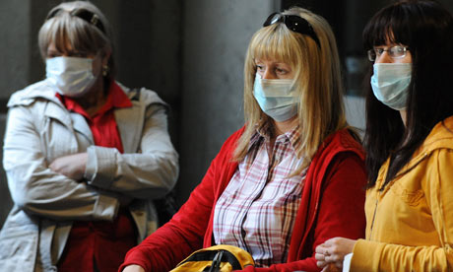
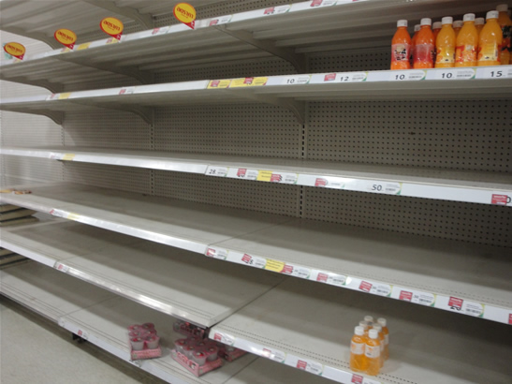
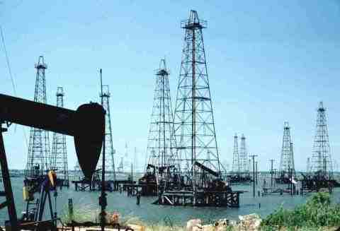
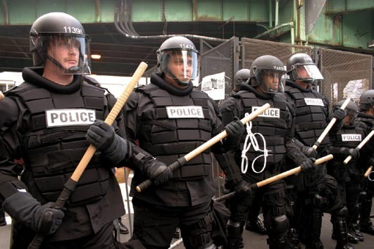
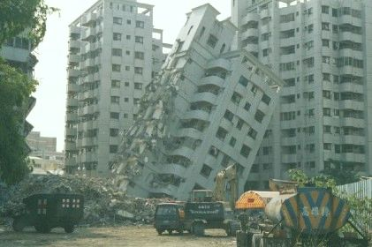

Slide 3
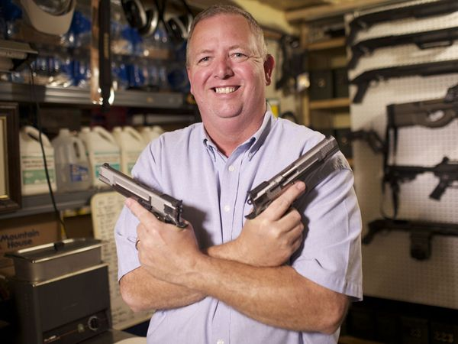
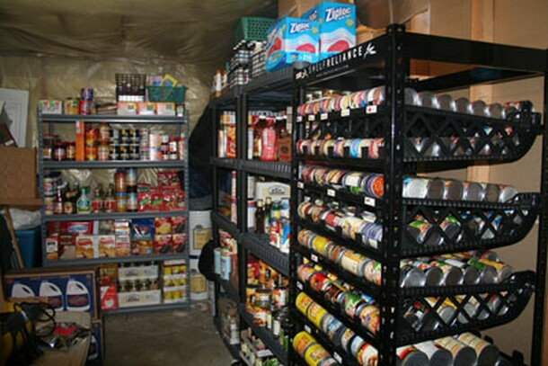
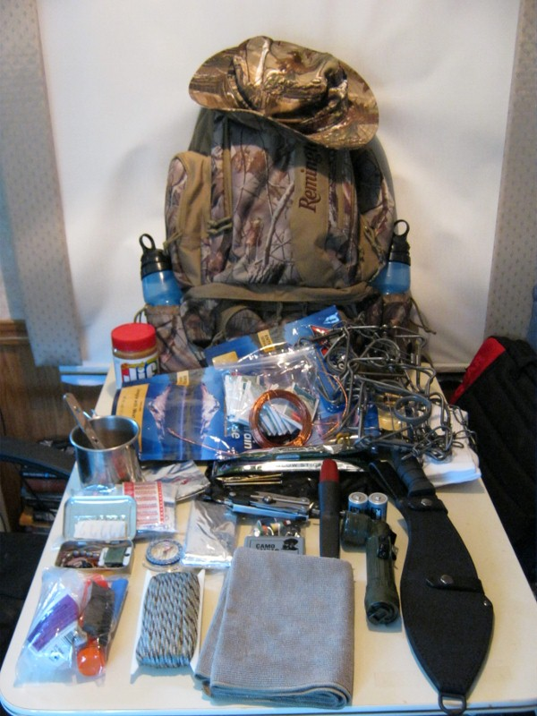
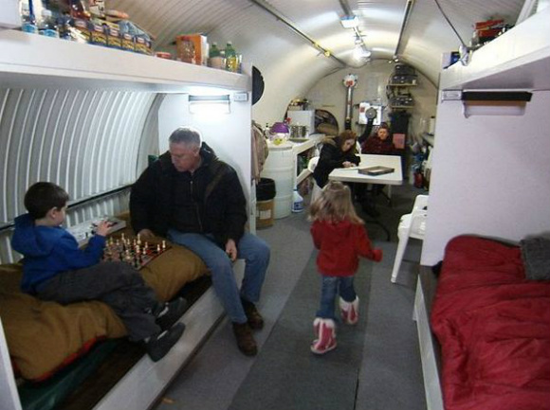
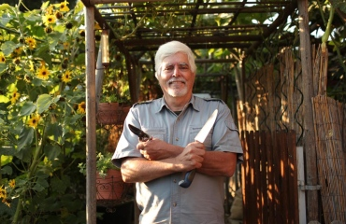

Slide 4
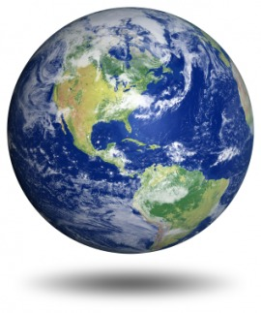
This world is not my home

Slide 5
This world is not my home
“Beloved, I beg you as sojourners and pilgrims, abstain from fleshly lusts which war against the soul.”
1 Peter 2:11

Slide 6
This world is not my home
“For our citizenship is in heaven, from which we also eagerly wait for the Savior, the Lord Jesus Christ, who will transform our lowly body that it may be conformed to His glorious body…”
Philippians 3:20-21

Slide 7
This world is not my home
“Do not lay up for yourselves treasures on earth, where moth and rust destroy and where thieves break in and steal; but lay up for yourselves treasures in heaven…”
Matthew 6:19-20

Slide 8
This world is not my home
“And do not fear those who kill the body but cannot kill the soul. But rather fear Him who is able to destroy both soul and body in hell.”
Matthew 10:28

Slide 9
The Second Coming of Christ
2 Peter 3:7-13
1 Thessalonians 5:1-3
2 Thessalonians 1:7-10

Slide 10
The Second Coming of Christ
No one knows when Jesus will return.
When He returns, the world will end.
He is returning in judgment.
He is returning to bring “everlasting destruction” upon those not prepared.
There will be no escape.
It will be a real “doomsday!”

Slide 11
Qualities Worthy of Consideration and Imitation
The certainty of the event
2 Cor. 5:10; Rom. 14:10-12
Preparation
Matt. 24:42-44, 1 Thess. 5:4-10
Desire to prepare others
Mark 16:15-16

