Slide 1
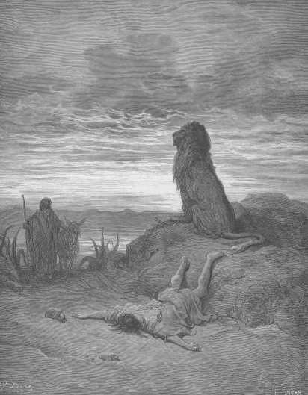
Lessons Learned Too Late
1 Kings 13

Slide 2
Lessons Learned Too Late
God Does Not Indulge In Self-Contradiction
Religious Leaders Do Not Always Tell the Truth
Sincerity Is No Excuse For Disobedience
Yesterday’s Obedience Will Not Atone For Today’s Disobedience
Partial Obedience Is Not Obedience

