Slide 1
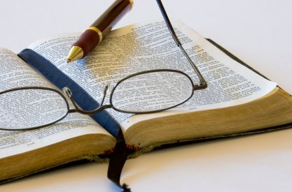
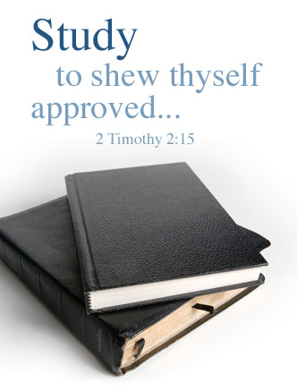
Why We Need To Study the Bible

Slide 2
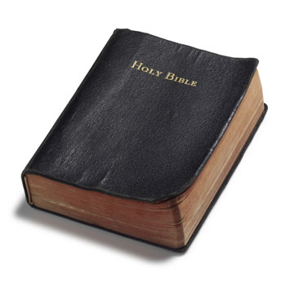
“Study to shew thyself approved unto God, a workman that needeth not to be ashamed, rightly dividing the word of truth.”
2 Timothy 2:15, KJV

Slide 3
“rightly dividing the word of truth”
“to cut” + “straight”
“to hold a straight course, to treat truthfully without falsification, to expound soundly”

Slide 4
Why We Need To Study the Bible
To Know the Will of God
To Know the Mind of God
To Strengthen Our Faith
To Receive Guidance
To Know How To Go To Heaven

Slide 5
What Is Required For Diligent Bible Study?

Slide 6
What Is Required For Diligent Bible Study?
A Bible

Slide 7
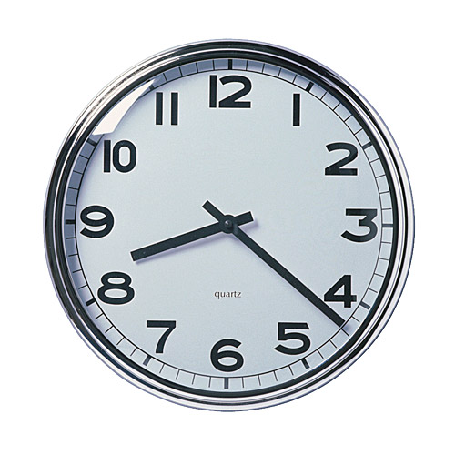
What Is Required For Diligent Bible Study?
A Bible
Time

Slide 8
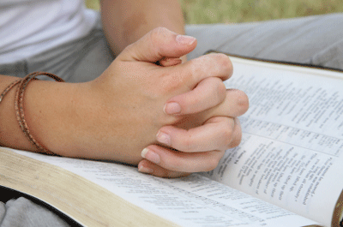
What Is Required For Diligent Bible Study?
A Bible
Time
Prayer

Slide 9
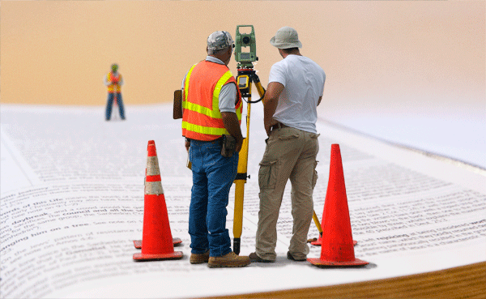
What Is Required For Diligent Bible Study?
A Bible
Time
Prayer
A Plan

Slide 10
Be a DBR in 2012

Slide 11
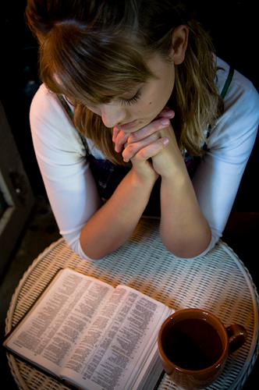
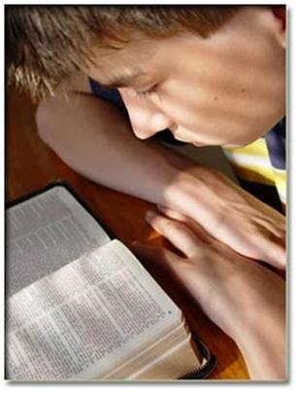
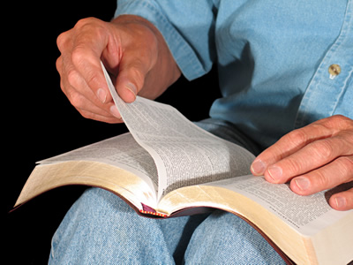
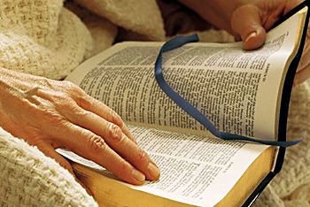
Be a DBR in 2012
Daily
Bible
Reader

