Slide 1
Paul’s Journey To Rome
An Example of God’s Providence

Slide 2
Paul Desired To Travel To Rome
Romans 1:8-15
He wanted to preach, impart spiritual gifts, and bear fruit among them.
He had often been hindered from traveling to them.
His prayer was that he find a way in the will of God to go to Rome.

Slide 3
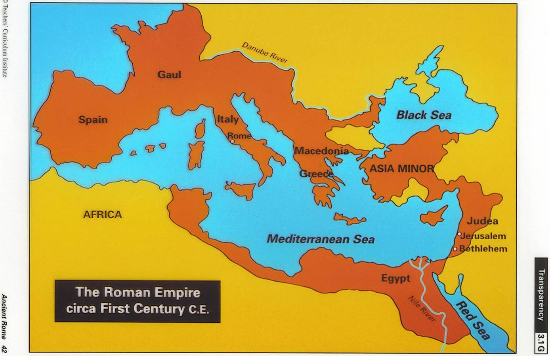
Romans 15:22-33

Slide 4
Romans 15:22-33

Slide 5
Romans 15:22-33

Slide 6
Romans 15:22-33

Slide 7
Paul asked that they pray for him regarding this trip, specifically that he be delivered from the Jews in Jerusalem who opposed his work (Rom. 15:31).
Paul realized that his plan was subject to the “will of God” (Rom. 1:10, 15:32).
Soon after he wrote the letter, he was made aware of the fact that things would not go well for him in Jerusalem (Acts 20:22-24, 21:4, 11).

Slide 8
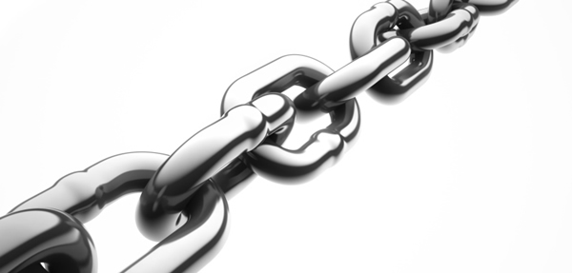
Each event that followed Paul’s arrival in Jerusalem became a link in the chain of God’s providence that finally brought Paul to Rome according to God’s will.

Slide 9
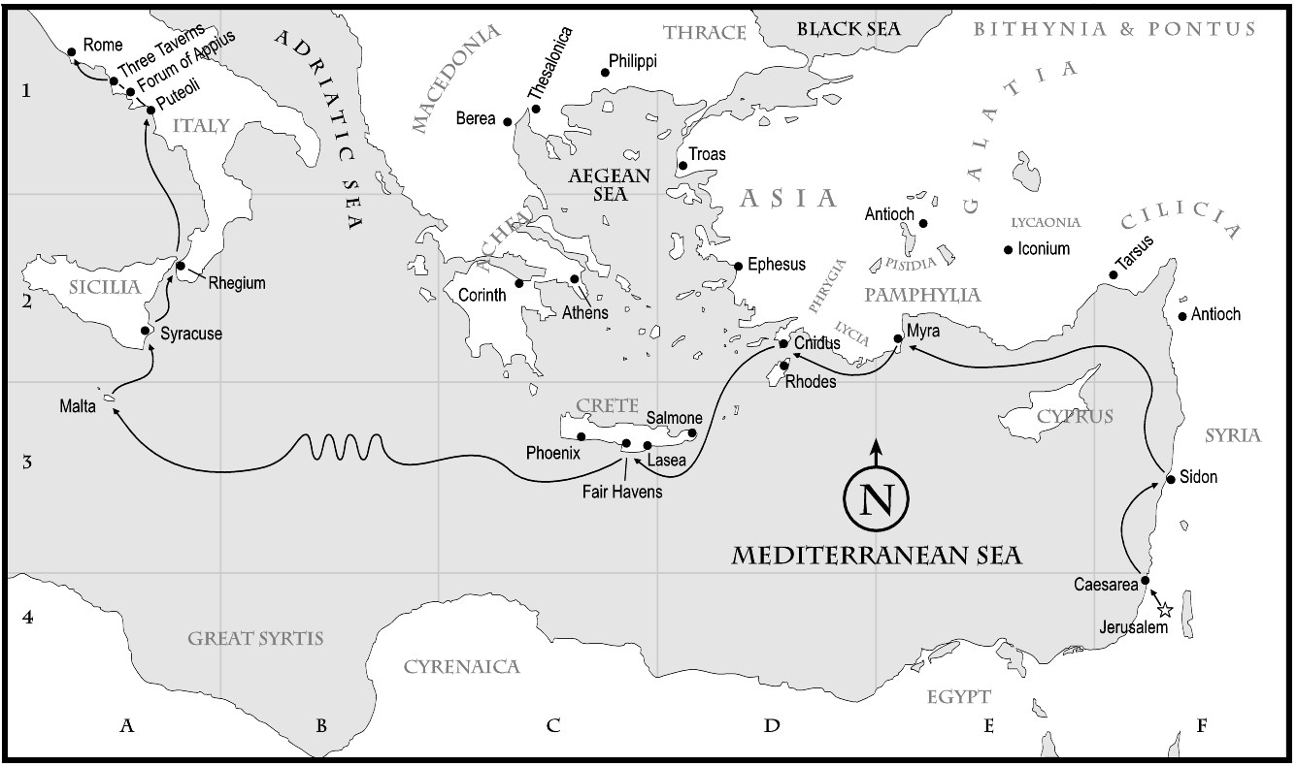

Slide 10
Benefits of Paul’s Imprisonment
The gospel spread throughout the whole palace guard, and even into Caesar’s household (4:22).
Paul’s courage and faithfulness gave Christians boldness.
The gospel was spread by them without fear.
Also, Paul’s imprisonment gave occasion for the writing of six books of the New Testament: Luke, Acts, Eph., Phil., Col., Phile.

Slide 11
God’s Providence and Us
We can see how God worked to bring about His will in the life of Paul.
Surely, if we take the time to look, we can see how God has brought about His will in our own lives as well.
“And we know that all things work together for good to those who love God, to those who are the called according to His purpose” (Rom. 8:28).

