Slide 1
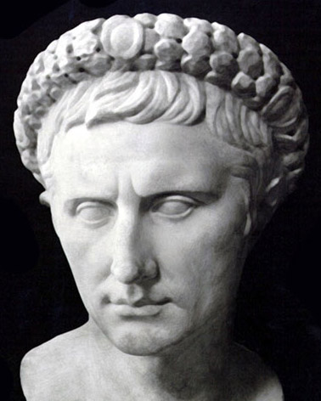
Pontius Pilate
A Case Study in Character Deficiency

Slide 2
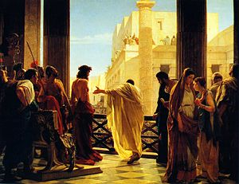
Pilate Gave Others the Right To Make His Decisions - Matthew 27:15-17

Slide 3
Pilate Gave Others the Right To Make His Decisions - Matthew 27:15-17
Pilate Sought To Please the People - Mark 15:15

Slide 4
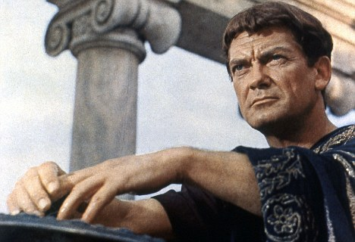
Pilate Gave Others the Right To Make His Decisions - Matthew 27:15-17
Pilate Sought To Please the People - Mark 15:15
Pilate Refused To Take Responsibility - Matthew 27:24

Slide 5
Pilate Gave Others the Right To Make His Decisions - Matthew 27:15-17
Pilate Sought To Please the People - Mark 15:15
Pilate Refused To Take Responsibility - Matthew 27:24
Pilate Was Motivated By Pride

Slide 6
Pilate Gave Others the Right To Make His Decisions - Matthew 27:15-17
Pilate Sought To Please the People - Mark 15:15
Pilate Refused To Take Responsibility - Matthew 27:24
Pilate Was Motivated By Pride
Pilate Had A Lack of Concern for the Truth - John 18:38

Slide 7
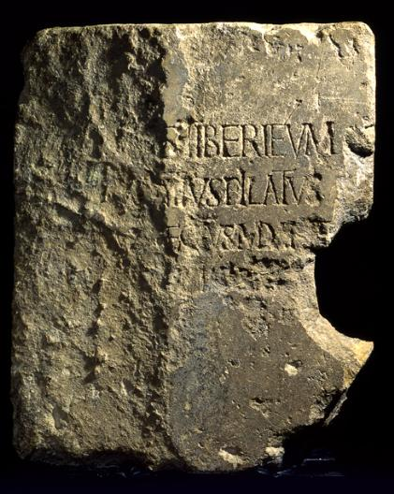
Pontius Pilate was a real person.
We don’t know much about his life before this event.
His life afterward is the subject of several conflicting traditions.
This was the defining moment in his life, and he failed miserably.

