Slide 1
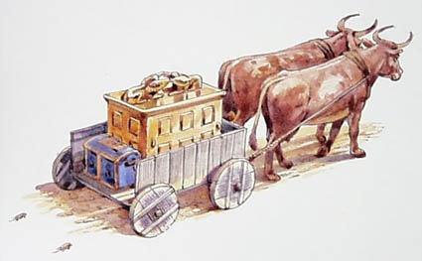
Uzza and the Ark
First Chronicles 13

Slide 2
Uzza and the Ark
The Seriousness of God’s Authority
The Danger of Neglect
Sincerity Alone Does Not Matter
Ignorance is No Excuse
God Honors Our Obedience

