Slide 1
Alternate Lifestyles

Slide 2
The words “alternate” and “alternative” imply a choice.
“Providing or being a choice between two (or, less strictly, among more than two) things” (Webster’s).
When we travel, we can take “alternate” routes.

Slide 3
1. Sexual Orientation
God did not give Adam a choice. He was given a woman (Gen. 2:18-24).
Jesus reinforced this pattern (Matt. 19:3-6).
Paul acknowledged the natural attraction and desire that exists between men and women (1 Cor. 7:1-3), yet condemned same-sex desire and attraction (Rom. 1:26-27).

Slide 4
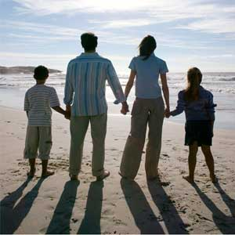
2. The Home

Slide 5
2. The Home
Ephesians 5:22-6:4
Wife is to submit to the leadership of her husband.
Husband is to provide leadership and love his wife.
Children are to obey their parents.
Parents are to nurture and care for their children.

Slide 6
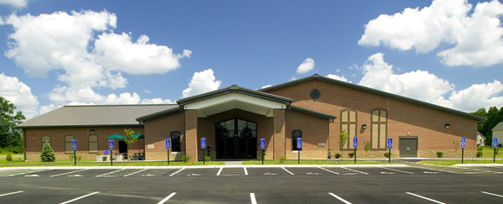
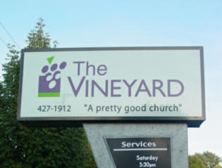
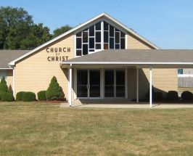
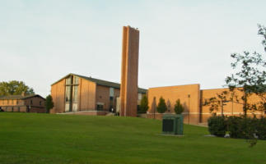
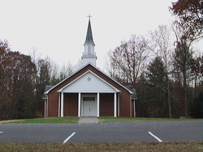
3. The Church
“Join the church of your choice!”

Slide 7
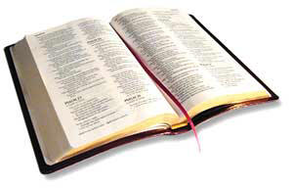
3. The Church
“And I also say to you that you are Peter, and on this rock I will build My church, and the gates of Hades shall not prevail against it.”
Matthew 16:18

Slide 8
3. The Church
“Praising God and having favor with all the people. And the Lord added to the church daily those who were being saved.”
Acts 2:47

Slide 9
3. The Church
“And He put all things under His feet, and gave Him to be head over all things to the church, which is His body, the fullness of Him who fills all in all.”
Ephesians 1:22-23

Slide 10
4. Worship

Slide 11
4. Worship
“But the hour is coming, and now is, when the true worshipers will worship the Father in spirit and truth; for the Father is seeking such to worship Him. God is Spirit, and those who worship Him must worship in spirit and truth.”
John 4:23-24

Slide 12
4. Worship
Praying - 1 Cor. 14:15
Singing - 1 Cor. 14:15
Lord’s Supper - 1 Cor. 11:23-26
Giving - 1 Cor. 16:1-2
Preaching - Acts 20:7

Slide 13
4. Worship
burning candles and incense
instrumental music
solos
testimonials
foot washing
snake handling
drama skits
comedy routines
magic shows

Slide 14
5. Plan of Salvation
“We are all going to Heaven, we are just getting there different ways!”

Slide 15
5. Plan of Salvation
“Though He was a Son, yet He learned obedience by the things which He suffered. And having been perfected, He became the author of eternal salvation to all who obey Him.”
Hebrews 5:8-9

Slide 16
5. Plan of Salvation
Believe - John 8:24
Repent - Luke 13:3
Confess Christ - Matt. 10:32-33
Baptized - Mark 16:16
Live Faithfully - Rev. 2:10

Slide 17
5. Plan of Salvation
“We are all going to Heaven, we are just getting there different ways!”

Slide 18
5. Plan of Salvation
“We are all going to Heaven, we are just getting there different ways!”
There are no alternate routes to Heaven!

Slide 19
“Alternate” Implies a Choice
There are some areas in which God has not granted a choice.
Sexual Orientation
The Home
The Church
Worship
How To Get To Heaven

