Slide 2
The Lord’s Supper
The Christian’s Memorial

Slide 3
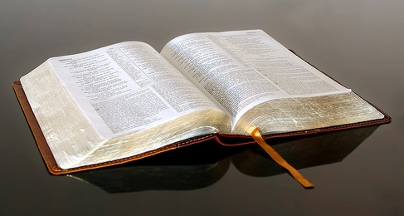
A Command of Christ
1 Corinthians 11:23-25

Slide 4
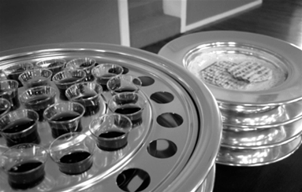
The Elements
Bread
Unleavened bread - Luke 22:1, 7, 15, 19
Fruit of the Vine
Luke 22:17-18, 20

Slide 5
When To Observe This Memorial
First Day of the Week - Acts 20:7
Frequency? How often should we/must we observe this memorial?
Every first day of the week.
Compare Acts 20:7 with Exodus 20:8-11.

Slide 6
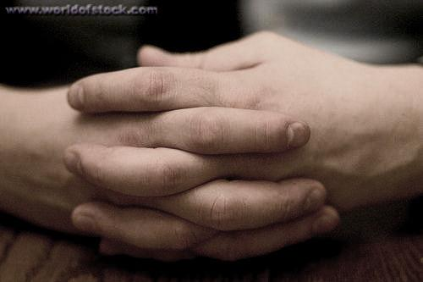
How To Observe This Memorial
1 Corinthians 11:27-30
Examine ourselves
Eat and drink in a worthy manner
Discern the Lord’s body
“In remembrance of Me”

Slide 8
Greater love hath no man than this, that a man lay down his life for his friends.
John 15:13

