Slide 1
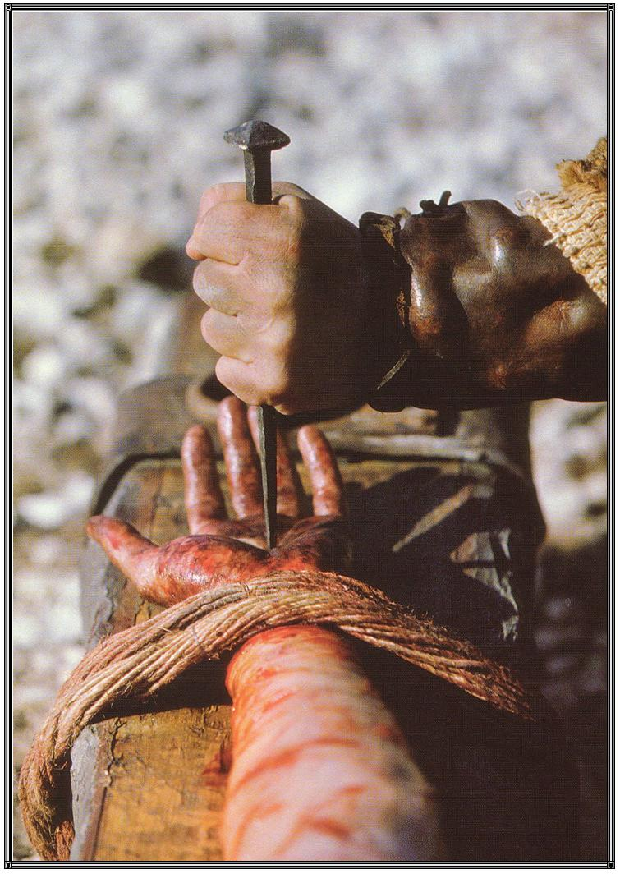
What Kept Jesus on the Cross?

Slide 2
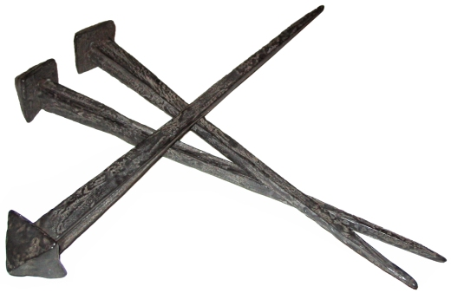
It wasn’t the nails!

Slide 3
It wasn’t the nails!
53 Or do you think that I cannot now pray to My Father, and He will provide Me with more than twelve legions of angels?
54 How then could the Scriptures be fulfilled, that it must happen thus?
Matthew 26:53-54

Slide 4
1. A Sense of Duty
The Scriptures had to be fulfilled - Matt. 26:54
Jesus came in obedience to God’s will and plan - Heb. 10:5-10
Jesus came to be the Suffering Servant of Isaiah 53.
We are to have the same servant mind as Christ - Phil. 2:5-10.

Slide 5
2. Love For the Father
The cross represents Christ’s love for the Father - John 14:29-31.
Love for God is shown by keeping His commands - John 14:15, 15:10, 1 John 5:3.
Jesus was not an exception to this rule.
The same love of Christ compels us to live in obedience to the Father - 2 Cor. 5:14-15

Slide 6
3. Trust in the Father
Jesus “committed Himself to Him who judges righteously” - 1 Peter 2:21-24.
The same righteous God will help us through our sufferings - 1 Pet. 4:19, Rom. 12:17-21.

Slide 7
4. The Joy Set Before Him
Hebrews 12:2
Jesus had a task to finish, a job to see through to the end.
Jesus endured the agony of the cross because He was able to look past the pain to see the results of his sacrifice.

Slide 8
4. The Joy Set Before Him
Sitting as Conqueror and King over His kingdom - Heb. 10:12-13, Acts 2:33-35.
Redeeming man back unto God - Rom. 5:8-11.
Reversing the curse of sin - Rom. 5:18-19.
Destroying the power of Satan (death) - 1 Cor. 15:54-57.
Delivering the kingdom back to the Father - 1 Cor. 15:24.

Slide 9
4. The Joy Set Before Us
Jesus calls us to join Him in His Father’s house.
We must follow Him, looking beyond the present discomfort of bearing our cross and focusing upon the joy that awaits us in Heaven with the Lord.

Slide 10
What Kept Jesus on the Cross?
A Sense of Duty
Love For the Father
Trust in the Father
The Joy Set Before Him

Slide 11
How Can We Bear Our Cross?
A Sense of Duty
Love For the Father
Trust in the Father
The Joy Set Before Us
“If anyone desires to come after Me, let him deny himself, and take up his cross, and follow Me.”
Matthew 16:24

