Slide 1
Dangers Facing the Church Today

Slide 2
Local Churches Were Warned Against Dangers
Acts 20:29-31
2 Peter 2:1-2
Revelation 2:4-5

Slide 3
1. Lack of Knowledge/Growth
The religion of Jehovah has always been a taught religion.
Old Testament: fathers taught their children, priests taught the people.
Apostles were to teach disciples to obey the commands of Christ (Matt. 28:19-20).
Those who were taught were to teach others (2 Tim. 2:2).

Slide 4
1. Lack of Knowledge/Growth
Ephesians 4:11-16
God gave the local church teachers, members are to come to a level of knowledge.
2 Peter – a letter that warns of false teachers also admonishes spiritual growth (1:2, 5-11, 3:18).

Slide 5
1. Lack of Knowledge/Growth
Sermons must be based upon and full of Scripture. “Preach the Word!” (2 Tim. 4:2).
Not stories, ideas, fads, fluff, or philosophy.
Need more time talking about the meaning of the text instead of what the text means to me.

Slide 6
1. Lack of Knowledge/Growth
Bible Classes are to be taught by capable men and women.
The Bible is to be taught.
Not a time for speculation, brainstorming, or “playing devil’s advocate.”
Not a time to join in a round-table discussion, open-forum debate.

Slide 7
1. Lack of Knowledge/Growth
New Converts need to be taught the commands of Christ.
Grounded in the truth.
Encouraged to a higher level of participation.

Slide 8
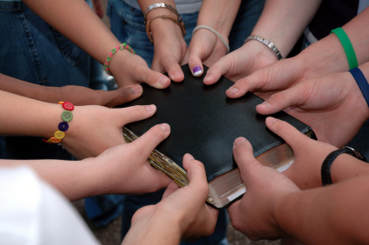
1. Lack of Knowledge/Growth
Young People need to be taught the Word of God early and often.
Well grounded in evidences.
Taught to be content to walk in the old paths (Jer. 6:16).

Slide 9
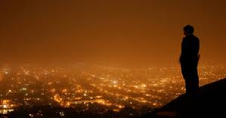
2. Worldliness
1 John 2:15-17
1 Peter 2:11-12
Philippians 3:20
Matthew 6:19-21, 24, 33

Slide 10
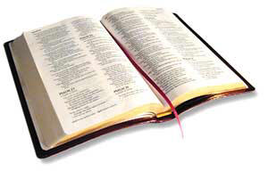
3. Lack of Discipline
Acts 5:5, 10
2 Thessalonians 3:6, 14-15
1 Timothy 5:20
1 Corinthians 5:1-7

Slide 11
3. Lack of Discipline
“Because the sentence against an evil work is not executed speedily, therefore the heart of the sons of men is fully set in them to do evil.”
Ecclesiastes 8:11

Slide 12
3. Lack of Discipline
20 Nevertheless I have a few things against you, because you allow that woman Jezebel, who calls herself a prophetess, to teach and seduce My servants to commit sexual immorality and eat things sacrificed to idols.
21 And I gave her time to repent of her sexual immorality, and she did not repent.
Revelation 2:20-21

Slide 13
Dangers Facing the Church Today
Lack of Knowledge
Worldliness
Lack of Discipline

