Slide 2

Timeless Truths in an
Ever-Changing World

Slide 3
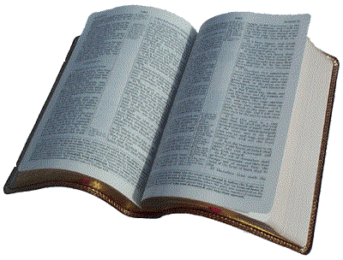
1. God Does Not Change
“For I am the LORD, I do not change; Therefore you are not consumed, O sons of Jacob.”
Malachi 3:6

Slide 4
1. God Does Not Change
God is a God of Reason - Isaiah 1:18
God is Sovereign - Psalm 99:1-3
God is Righteous - Psalm 97:2

Slide 5
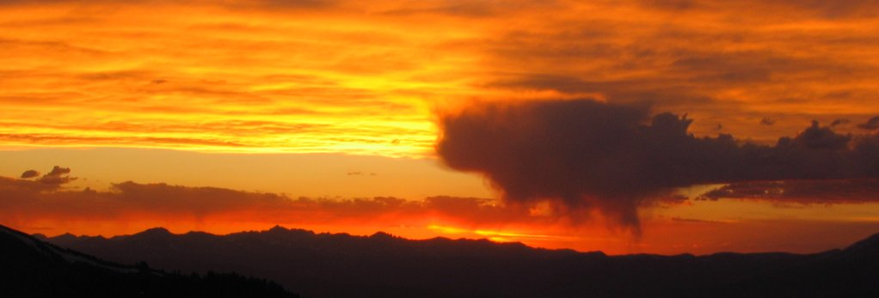
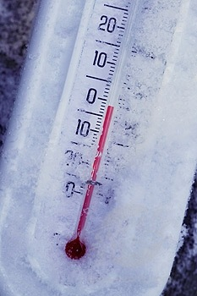
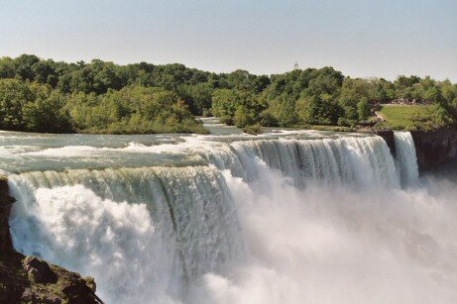
2. God’s Law Does Not Change

Slide 6
2. God’s Law Does Not Change
“Woe to those who call evil good, and good evil; who put darkness for light, and light for darkness; who put bitter for sweet, and sweet for bitter!
Woe to those who are wise in their own eyes, and prudent in their own sight!”
Isaiah 5:20-21

Slide 7
3. God’s Word Does Not Change
“Forever, O Lord, Your word is settled in heaven”
Psalm 119:89

Slide 8
4. God’s Promises Do Not Change
“No temptation has overtaken you except such as is common to man; but God is faithful, who will not allow you to be tempted beyond what you are able, but with the temptation will also make the way of escape, that you may be able to bear it.”
1 Cor. 10:13

Slide 9
4. God’s Promises Do Not Change
God has promised a Day of Judgment.
  2 Pet. 3:5-9
God has promised a way for us to escape Judgment.
  2 Pet. 3:9, 2 Thess. 1:8

Slide 10
Timeless Truths
God Does Not Change
God’s Standards and Laws Do Not Change
God’s Word Does Not Change
God’s Promises Do Not Change

