Slide 2
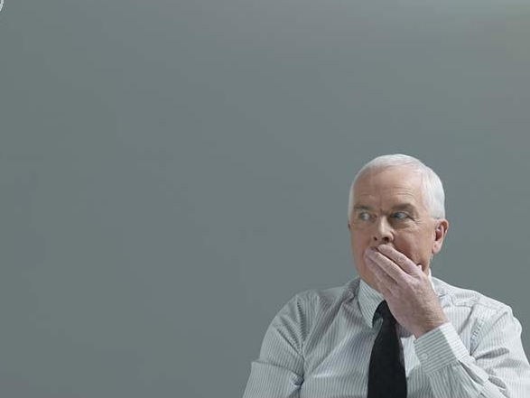
Sins of the Tongue

Slide 3
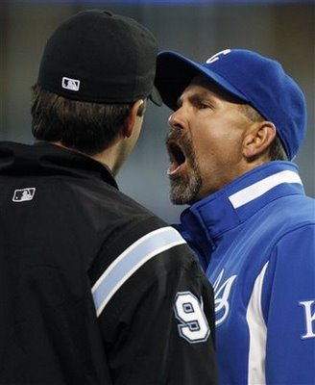
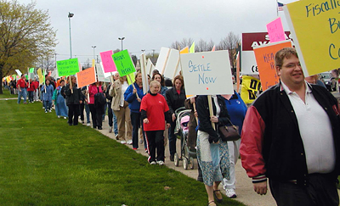
Complaining

Slide 4
1 Corinthians 10:1-12
Lusted after evil things - v. 6
Became idolaters - v. 7
Committed fornication - v. 8
Tempted Christ - v. 9
Complained - v. 10

Slide 5
murmur “a mumbled or muttered complaint” (Webster’s).
complain
1. to claim or express pain, displeasure, etc.
2. to find fault; declare annoyance
3. to make an accusation; bring a formal charge (Webster’s).

Slide 6
gonguzo “to mutter, murmur, grumble, say anything in a low tone; an onomatopoeic word, representing the significance by the sound of the word” (Vine’s).
“to murmur, mutter, grumble, say anything in a low tone (Thayer's).

Slide 7
Complaining is a Sin

Slide 8
Complaining is a Sin
Those who complained against God and His servants suffered God’s wrath.
Christians are told to learn from their example - 1 Cor. 10:6, 11

Slide 9
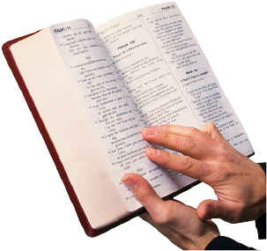
Complaining is a Sin
“Do all things without complaining and disputing, that you may become blameless and harmless, children of God without fault in the midst of a crooked and perverse generation, among whom you shine as lights in the world.”
Philippians 2:14-15

Slide 10
Complaining is a Sin
“Do not grumble against one another, brethren, lest you be condemned. Behold, the Judge is standing at the door!”
James 5:9

Slide 11
Complaining is a Sin
“Be hospitable to one another without grumbling.”
1 Peter 4:9

Slide 12
Complaining is a Sin
“These are grumblers, complainers, walking according to their own lusts; and they mouth great swelling words, flattering people to gain advantage.”
Jude 16

Slide 13
What is Wrong With Complaining?
There is a place for legitimate complaints - Acts 6:1
We are to bear with one another, not complain about one another - Eph. 4:1-3
We are to walk in love towards one another - Eph. 5:1-2, 1 Cor. 13:4-7

Slide 14
What is Wrong With Complaining?
Complaining against God is a sin against God.
Denies God of His sovereignty, makes us his judge - Rom. 9:20-21.
Denies God’s care and provision - Mark 4:38.
God gives us life and all good things - Acts 17:25, James 1:17
His commandments are not burdensome - 1 John 5:3

Slide 15
What is Wrong With Complaining?
Complaining takes the place of prayer.

Slide 16
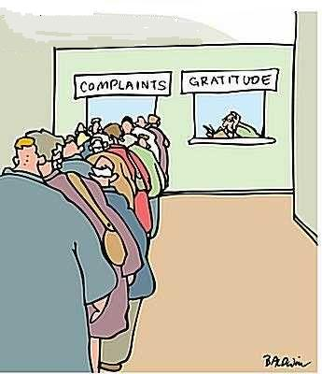
What is Wrong With Complaining?
Complaining takes the place of prayer.
We are to count our blessings, not voice our complaints.

Slide 17
What is Wrong With Complaining?
Complaining takes the place of prayer.
We are to count our blessings, not voice our complaints.
We are to learn to be content, not complain - Phil. 4:11-13

Slide 18
What is Wrong With Complaining?
Complaining takes the place of prayer.
We are to count our blessings, not voice our complaints.
We are to learn to be content, not complain - Phil. 4:11-13
Complaining does not advance the cause of Christ - Phil. 2:14-15.

Slide 19
What is Wrong With Complaining?
Complaining takes the place of prayer.
We are to count our blessings, not voice our complaints.
We are to learn to be content, not complain - Phil. 4:11-13
Complaining does not advance the cause of Christ - Phil. 2:14-15.
We need to get busy.

