Slide 1
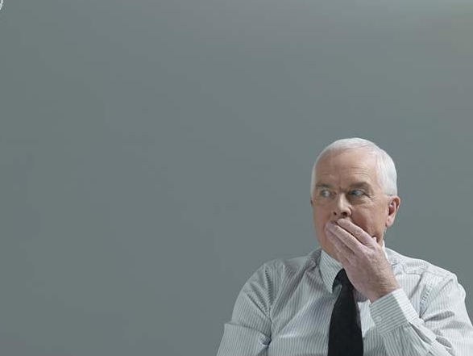
Sins of the Tongue

Slide 2
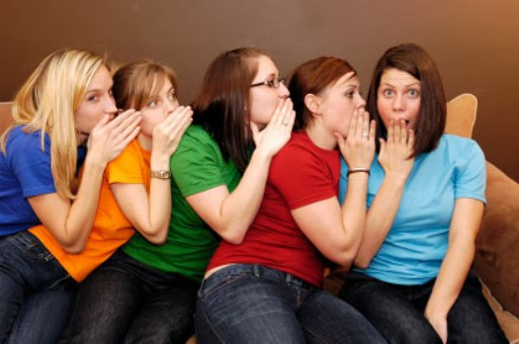
Gossip

Slide 3
Gossip “a person who chatters or repeats idle talk and rumors, especially about the private affairs of others” (Webster’s).
Slander “the utterance in the presence of another person of a false statement or statements, damaging to a third person’s character or reputation” (Webster’s).

Slide 4
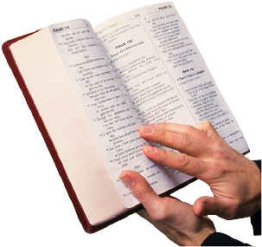
Like most sins, gossip is enjoyable.
“The words of a talebearer are like tasty trifles, and they go down into the inmost body.”
Proverbs 18:8

Slide 5
Damage Caused By Gossip

Slide 6
Damage Caused By Gossip
Reveals Secrets
“A talebearer reveals secrets, but he who is of a faithful spirit conceals a matter” (Prov. 11:13).

Slide 7
Damage Caused By Gossip
Separates Friends
“A perverse man sows strife, and a whisperer separates the best of friends” (Prov. 16:28).

Slide 8
Damage Caused By Gossip
Brings Anger
“The north wind brings forth rain, and a backbiting tongue an angry countenance” (Prov. 25:23).

Slide 9
Damage Caused By Gossip
Kindles Strife
“Where there is no wood, the fire goes out; and where there is no talebearer, strife ceases. As charcoal is to burning coals, and wood to fire, so is a contentious man to kindle strife” (Prov. 26:20-21).

Slide 10
Damage Caused By Gossip
Shows Us To Be A Fool
“He who has knowledge spares his words, and a man of understanding is of a calm spirit. Even a fool is counted wise when he holds his peace; when he shuts his lips, he is considered perceptive” (Prov. 17:27-28).

Slide 11
Damage Caused By Gossip
Reveals Secrets
Separates Friends
Brings Anger
Kindles Strife
Shows Us To Be A Fool

Slide 12
How To Overcome the Sin of Gossip
Questions I should ask myself before I repeat something.

Slide 13
How To Overcome the Sin of Gossip
Is it true? Prov. 18:13, 17
Is it going to build up or tear down? Rom. 14:19
Have I talked to them first? Matt. 18:15-17
Have I examined myself? Matt. 7:3-5
Why am I really wanting to do this? Prov. 17:9
How would I want to be treated? Matt. 7:12

Slide 14
Gossip is a Sin!
“You shall not go about as a talebearer among your people…” Leviticus 19:16

