Slide 1
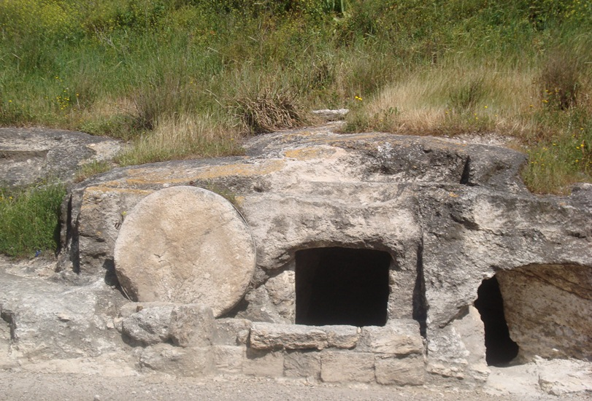
“Take Away the Stone”
John 11:39

Slide 2
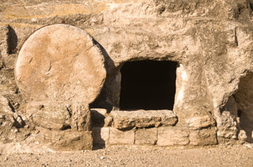

Slide 3
“Take away the stone.”

Slide 4
“Take away the stone.”
“Loose him, and let him go.”

Slide 5
“Take away the stone.”
“Loose him, and let him go.”
Why didn’t Jesus remove the stone and release Lazarus Himself?

Slide 6
God Never Does For Man What Man Can Do For Himself
Tuning water into wine (John 2)
Feeding the 5,000 (John 6)
Healing the man born blind (John 9)
Noah built his own ark (Heb. 11:7)
Deliverance of Israel from Egypt (Ex. 3:7-10)
Deliverance from Fiery Serpents (Num. 21:8-9)

Slide 7
God Always Does For Man What Man Is Unable To Do For Himself
God saves us (Titus 3:5, Eph. 2:8-9)
Made the plan of salvation (Gal. 1:11, 2 Tim. 1:9)
Furnished the sacrifice (John 3:16)
Sets forth conditions to be met (Heb. 5:9)
Gives us time and opportunity (2 Pet. 3:9)
Adds us to the church (Acts 2:47)

Slide 8
Man Must Do His Part

Slide 9
Man Must Do His Part
Believe
“Therefore I said to you that you will die in your sins; for if you do not believe that I am He, you will die in your sins” (John 8:24).

Slide 10
Man Must Do His Part
Repent
“Truly, these times of ignorance God overlooked, but now commands all men everywhere to repent” (Acts 17:30).

Slide 11
Man Must Do His Part
Confess Christ
“That if you confess with your mouth the Lord Jesus and believe in your heart that God has raised Him from the dead, you will be saved. For with the heart one believes unto righteousness, and with the mouth confession is made unto salvation” (Romans 10:9-10).

Slide 12
Man Must Do His Part
Be Baptized
“Then Peter said to them, ‘Repent, and let every one of you be baptized in the name of Jesus Christ for the remission of sins; and you shall receive the gift of the Holy Spirit’” (Acts 2:38).

Slide 13
“Take Away the Stone”

Slide 14
“Take Away the Stone”
“O Jerusalem, Jerusalem, the one who kills the prophets and stones those who are sent to her! How often I wanted to gather your children together, as a hen gathers her chicks under her wings, but you were not willing!”
Matthew 23:37

Slide 15
“Take Away the Stone”
“O Jerusalem, Jerusalem, the one who kills the prophets and stones those who are sent to her! How often I wanted to gather your children together, as a hen gathers her chicks under her wings, but you were not willing!”
Matthew 23:37
Are you willing to take away the stone so that Jesus can give you life?

