Slide 1
The Deacon and His Work

Slide 2
Special use of a generic word

Slide 3
Special use of a generic word
Elder
Commonly referred to older people.
Technical term for those appointed to oversee the local church.

Slide 4
Special use of a generic word
Elder
Commonly referred to older people.
Technical term for those appointed to oversee the local church.
DIAKONOS (Deacon)
Ordinary word for servant.
Technical term for those who serve as deacons.

Slide 5
Deacons Are Not Rulers

Slide 6
Deacons Are Not Rulers
A deacon serves, carrying out the command of another.

Slide 7
Deacons Are Not Rulers
A deacon serves, carrying out the command of another.
Elders are over deacons.

Slide 8
Deacons Are Servants

Slide 9
Deacons Are Servants
DIAKONOS
“One who executes the commands of another, especially of a master; a sergeant, attendant, minister” (Thayer).

Slide 10
Deacons Are Servants
DIAKONOS
“One who executes the commands of another, especially of a master; a sergeant, attendant, minister” (Thayer).
“let them serve as deacons…” (1 Tim. 3:10).

Slide 11
Deacons Are Servants
DIAKONOS
“One who executes the commands of another, especially of a master; a sergeant, attendant, minister” (Thayer).
“let them serve as deacons…” (1 Tim. 3:10).
“For those who have served well as deacons…” (1 Tim. 3:13).

Slide 12
Extent of a Deacon’s Work

Slide 13
Extent of a Deacon’s Work
They relieve the elders.
Acts 6:1-4

Slide 14
Extent of a Deacon’s Work
Primarily of a physical nature:
Benevolence
Physical needs of members
Care for building
Prepare for worship
Charge of teaching program
Bookwork/Treasurer

Slide 15
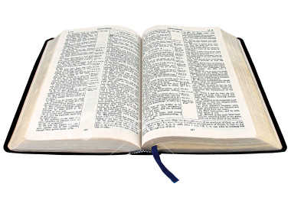
“For those who have served well as deacons obtain for themselves a good standing and great boldness in the faith which is in Christ Jesus.”
1 Timothy 3:13

