Slide 1
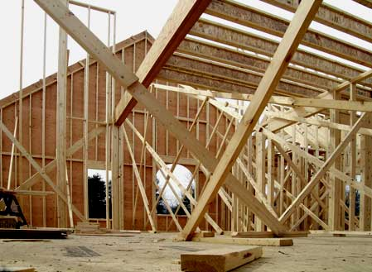
Make All Things According to the Pattern
Hebrews 8:5

Slide 2
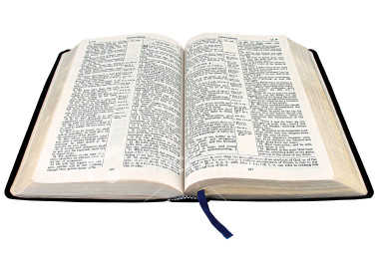
“Who serve the copy and shadow of the heavenly things, as Moses was divinely instructed when he was about to make the tabernacle. For He said, ‘See that you make all things according to the pattern shown you on the mountain.’”
Hebrews 8:5

Slide 3
1. Marriage & Family

Slide 4
1. Marriage & Family
Matthew 19:3-9

Slide 5
1. Marriage & Family
Matthew 19:3-9
Does away with
living together
same-sex marriages
polygamy
no-fault divorce
etc.

Slide 6
1. Marriage & Family
Colossians 3:18-21

Slide 7
1. Marriage & Family
Colossians 3:18-21
Wife submit to husband
Husband love his wife
Children obey parents
Parents raise their children

Slide 8
2. Godly Living

Slide 9
2. Godly Living
Colossians 3:5-16

Slide 10
2. Godly Living
Colossians 3:5-16
Put To Death: fornication, uncleanness, passion, evil desire, covetousness.

Slide 11
2. Godly Living
Colossians 3:5-16
Put To Death: fornication, uncleanness, passion, evil desire, covetousness.
Put Off: anger, wrath, malice, blasphemy, filthy language, lies.

Slide 12
2. Godly Living
Colossians 3:5-16
Put To Death: fornication, uncleanness, passion, evil desire, covetousness.
Put Off: anger, wrath, malice, blasphemy, filthy language, lies.
Put On: tender mercies, kindness, humility, meekness, longsuffering, forbearance, forgiveness, love.

Slide 13
3. The Lord’s Church

Slide 14
3. The Lord’s Church
Jesus built His church - Matt. 16:18

Slide 15
3. The Lord’s Church
Jesus built His church - Matt. 16:18
The pattern for the church that Jesus built can be found in the New Testament.

Slide 16
3. The Lord’s Church
WORSHIP

Slide 17
3. The Lord’s Church
WORSHIP
Lord’s Supper - 1 Cor. 11:23-26
Collection - 1 Cor. 16:1-2
Singing - 1 Cor. 14:15
Prayer - 1 Cor. 14:15
Preaching - Acts 2:42

Slide 18
3. The Lord’s Church
WORSHIP
There is no pattern for burning incense or candles, solos or choirs, skits or plays, praise dancing, etc.

Slide 19
3. The Lord’s Church
WORK

Slide 20
3. The Lord’s Church
WORK
Evangelism - 1 Tim. 3:15
Edification - Eph. 4:11-12
Limited Benevolence - Rom. 15:26

Slide 21
3. The Lord’s Church
WORK
The church in the Bible did not engage in social, political, recreational, or educational campaigns.

Slide 22
3. The Lord’s Church
ORGANIZATION

Slide 23
3. The Lord’s Church
ORGANIZATION
Philippians 1:1
Bishops (Elders, Pastors)
Deacons

Slide 24
3. The Lord’s Church
NAME

Slide 25
3. The Lord’s Church
NAME
Church of God - 1 Cor. 1:2, 11:22
Church of the living God - 1 Tim. 3:15
Church of the firstborn - Heb. 12:23
Churches of Christ - Rom. 16:16

Slide 26
3. The Lord’s Church
WORSHIP
WORK
ORGANIZATION
NAME

Slide 27
4. Plan of Salvation

Slide 28
4. Plan of Salvation
Believe - John 8:24

Slide 29
4. Plan of Salvation
Believe - John 8:24
Repent - Luke 13:3

Slide 30
4. Plan of Salvation
Believe - John 8:24
Repent - Luke 13:3
Confess Christ - Rom. 10:9-10

Slide 31
4. Plan of Salvation
Believe - John 8:24
Repent - Luke 13:3
Confess Christ - Rom. 10:9-10
Be Baptized - Mark 16:16

Slide 32
4. Plan of Salvation
Believe - John 8:24
Repent - Luke 13:3
Confess Christ - Rom. 10:9-10
Be Baptized - Mark 16:16
Remain Faithful - Rev. 2:10

Slide 33
God’s Word Provides A Pattern
Marriage and Family
Godly Living
The Church
Plan of Salvation

