Slide 1
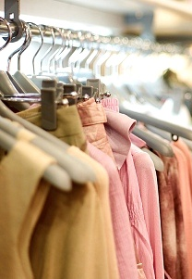
Immodest Dress
Does God Care About What I Wear?

Slide 2
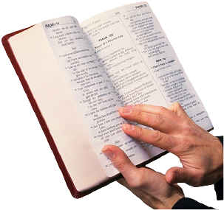
“Therefore ‘Come out from among them and be separate,’ says the Lord. ‘Do not touch what is unclean, and I will receive you. I will be a Father to you, and you shall be My sons and daughters,’ says the Lord Almighty”
2 Corinthians 6:17-18

Slide 3
“And do not be conformed to this world, but be transformed by the renewing of your mind, that you may prove what is that good and acceptable and perfect will of God”
Romans 12:2

Slide 4
Principles Pertaining To Our Dress and Appearance

Slide 5
“In like manner also, that the women adorn themselves in modest apparel, with propriety and moderation, not with braided hair or gold or pearls or costly clothing, but, which is proper for women professing godliness, with good works”
1 Timothy 2:9-10

Slide 6
“In like manner also, that the women adorn themselves in modest apparel, with propriety and moderation, not with braided hair or gold or pearls or costly clothing, but, which is proper for women professing godliness, with good works”
1 Timothy 2:9-10

Slide 7
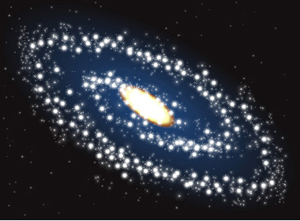
“Modest”
kosmios
“well arranged, orderly”
“Respectable, honorable. Expression of self-control, well mannered, disciplined.”

Slide 8
“Propriety” “Shamefacedness”
“a sense of shame”
“Precedes and prevents the shameful act.”
“That which restrains a good man or woman from an unworthy act”

Slide 9

“Moderation” “Sobriety”
“good judgment, moderation, self-control”
“Moderation” would hold a check on and restrain anything to which “propriety” would be opposed.

Slide 10
How do these principles work together?
Modesty
Tells us what is right.
Propriety
Recognizes the limitations.
Moderation
Keeps us from going beyond these limitations.

Slide 11

Why Should I Be Concerned About the Way That I Dress?

Slide 12
1. I Should Be Ashamed To Be Naked

Slide 13
1. I Should Be Ashamed To Be Naked
“…and white garments, that you may be clothed, that the shame of your nakedness may not be revealed…”
Revelation 3:18

Slide 14
1. I Should Be Ashamed To Be Naked
“Behold, I am coming as a thief. Blessed is he who watches, and keeps his garments, lest he walk naked and they see his shame”
Revelation 16:15

Slide 15
1. I Should Be Ashamed To Be Naked
“‘Behold, I am against you,’ says the Lord of hosts; ‘I will lift your skirts over your face, I will show the nations your nakedness, and the kingdoms your shame”
Nahum 3:5

Slide 16
1. I Should Be Ashamed To Be Naked
One does not have to be completely “nude” to be Biblically “naked.”
Genesis 3:10-11 - Adam admitted that he was “naked” with his covering.
Genesis 3:21 - God “clothed them”

Slide 17
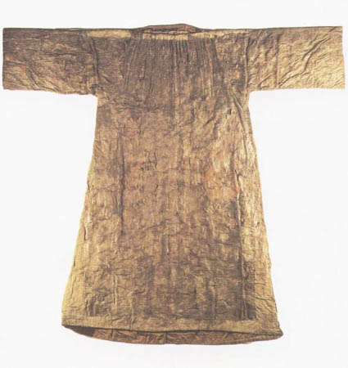
1. I Should Be Ashamed To Be Naked
God’s covering was a “tunic,” “coat,” “garment”
“a long shirt-like garment”

Slide 18
1. I Should Be Ashamed To Be Naked
thigh
“Take the millstones and grind meal. Remove your veil, take off the skirt, uncover the thigh, pass through the rivers. Your nakedness shall be uncovered, yes, your shame will be seen” (Isaiah 47:2-3).

Slide 19
1. I Should Be Ashamed To Be Naked
buttocks
“So shall the king of Assyria lead away the Egyptians as prisoners and the Ethiopians as captives, young and old, naked and barefoot, with their buttocks uncovered, to the shame of Egypt” (Isaiah 20:4).

Slide 20
1. I Should Be Ashamed To Be Naked
breasts
“I made you thrive like a plant in the field; and you grew, matured, and became very beautiful. Your breasts were formed, your hair grew, but you were naked and bare” (Ezekiel 16:7).

Slide 21
2. Do Not Want To Advertise Something About Myself That Is Not True
Our clothing sends a message about ourselves.
One can profess godliness (1 Tim. 2:10) or one can profess to be a harlot (Prov. 7:10).
Clothing is going to do what it has been designed to do, regardless of who is wearing it.

Slide 22
3. Do Not Want To Cause One To Stumble

Slide 23
3. Do Not Want To Cause One To Stumble
“It is impossible that no offenses should come, but woe to him through whom they do come! It would be better for him if a millstone were hung around his neck, and he were thrown into the sea, than that he should offend one of these little ones”
Luke 17:1-2

Slide 24
God Is Concerned About the Way I Dress
God wants me to dress modestly, with propriety and moderation.
God wants me to dress in a way that professes godliness.
God has defined nakedness, and wants me to be ashamed to be naked.
God does not want me to make myself an object of lust, causing others to sin.

