Slide 2
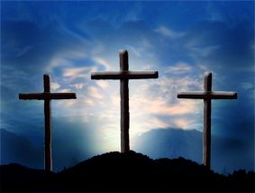
Different Looks At The Cross
Lk. 23:39-43

Slide 3
Rebellious Cross
Mt. 27:41-44.
Lk. 23:39.
Lk. 13:3, 5.
Lk. 5:24; Mt. 9:6.
Jn. 8:24.
Rom. 6:23.

Slide 4
Redeeming Cross
Jn. 19:19-21.
Isa. 59:20-21.
Rom. 11:26-27.
Lk. 24:46-47.
Eph. 2:17.
Matt. 20:28.
Eph. 1:7.
Col. 1:14.
1 Jn. 2:2.
1 Thess. 1:9-10.

Slide 5
Redeemed Cross
Lk. 23:40-43.
Mt. 9:6.
Heb. 9:15.
Rom. 6:17-18.
1 Pet. 2:24.
Rom. 6:3-5.

Slide 6
Redeeming Cross
Redeemed Cross
Rebellious Cross
Died For Sin
Died In Sin
Died To Sin

Slide 7
“What Must I Do To Be Saved?”
Hear The Gospel (Rom. 10:17)
Believe In Christ (Jn. 8:24)
Repent Of Sins (Lk.13:3)
Confess Christ (Rom. 10:10)
Be Baptized (I Pet. 3:21)
For The Erring Child:
Repent (Acts 8:22), Confess (I Jn. 1:9),
Pray (Acts 8:22)

