Slide 1
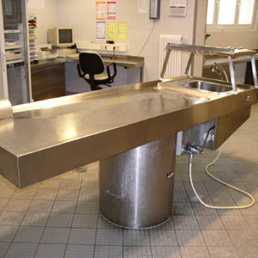
The Autopsy of a Dead
Faith
Why Perform Autopsies?
How Do the Living benefit From an Autopsy?
How Do You Resurrect a Dead Faith?
Notes:
Title Slide: The Autopsy of A Dead Faith…Overview…

Slide 2
What Is a Dead Faith?
DEAD – “applies literally to what is deprived of vital force but is used figuratively of anything that has lost any attribute (as energy, activity, radiance) suggesting life” – (Merriam Webster)
Notes:
What Is a Dead Faith? Dead…defined by Merriam Webster Dictionary. Notice there is nothing that shows any spark of activity—no benefit is being received.

Slide 3
Dead Faith
“Thus also faith by itself, if it does not have works, is dead.” {James 2:17}
Notes:
Dead Faith—Jam.2:17…

Slide 4
Dead Faith
“But do you want to know, O foolish man, that faith without works is dead?” {James 2:20}
Notes:
Dead Faith—Jam.2:20…

Slide 5
Dead Faith
“For as the body without the spirit is dead, so faith without works is dead also.” {James 2:26}
Notes:
Dead Faith—Jam.2:26…

Slide 6
Dead Faith Is Faith That Does Not Obey God
It cannot save.
James 2:14,24
It has no compassion.
James 2:15,16
It bears no fruit.
James 2:18-20
Notes:
Dead Faith Is Faith That Does Not Obey God…
Cannot save—Jam.2:14,24. Without being mixed with godly works, faith has no life.
Has no compassion—Jam.2:15,16. One has opportunity to demonstrate his faith but doesn’t. (1 Jno.3:17,18)
Has no fruit—Jam.2:18-20. God wants to SEE our faith at work. Lk.5:20.

Slide 7
Dead Faith Is Faith That Does Not Obey God
It has no fellowship with God.
James 2:19, 21-23
It rejects God’s people.
James 2:25; 3 John 1:9-11
It does not obey the gospel.
Romans 10:16
Notes:
Dead Faith Is Faith That Does Not Obey God…
(4) Has no fellowship with God—Jam.2:19,21-23. Faith cannot be complete without obedience.
(5) Rejects God’s people.—Jam.2:25; 3 Jno.1:9-11. One cannot have proper faith without accepting God’s people—their brethren.
(6) Does not obey the gospel—Rom.10:16. Rejects opportunity after opportunity to take the step of faith and obedience!

Slide 8
Dead Faith Is Faith That Does Not Obey God
It transgresses and does not abide in the doctrine of Christ.
2 John 9-11
It cannot please God.
Hebrews 11:6
Notes:
Dead Faith Is Faith That Does Not Obey God…
(7) Transgresses and does not abide in the doctrine of Christ—2 John 9-11. One who refuses to abide in the teachings of Christ does not have proper Bible faith.
(8) Cannot please God.—Heb.11:6. Unless a person’s FAITH is mixed with Bible obedience, it cannot save him!

Slide 9
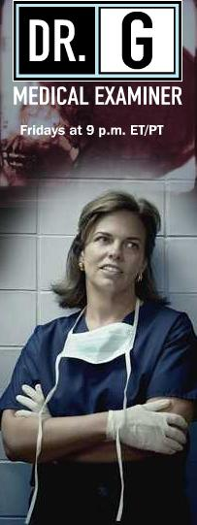
Why Does Faith Die?
Diminished respect for God and His Word
Proverbs 1:7; Psalm 112:1
Malnourishment
Hosea 4:6; 1 Peter 2:1,2
Ungodly attitudes
1 Samuel 15:17; 2 Timothy 4:10
Notes:
Why Does Faith Die?
Diminished respect for God and His Word—Prov.1:7; Psa.112:1; Heb.4:1. Faith will die if God’s word is not respected and followed. Such an attitude will cause a person to leave the paths of truth.
Malnourishment.—Hos.4:6; 1 Pet.2:1,2; Rom.10:17. Proper faith must be constantly fed with God’s word!
Ungodly attitudes—1 Sam.15:17; 2 Jno. 9,10; 2 Tim.4:10. Pride, selfishness, worldliness, anger, jealousy, etc. are attitudes that will cause true faith to die a slow, agonizing death.

Slide 10
Why Does Faith Die?
Bitterness
Ephesians 4:31; Hebrews 12:15
Indifference
Matthew 24:12; Revelation 3:15-19
Neglect
Hebrews 2:3; 4:11; Matthew 25:24-26
Notes:
Why Does Faith Die?
4) Bitterness—Eph.4:31; Heb.12:15. This cancerous attitude quietly affects a person’s faith—souring it and his life.
(5) Indifference. Matt.24:12; Rev.3:15-19. One cannot treat his faith with indifference or apathy—it will slowly die away.
(6) Neglect— Heb. 2:3;4:11; Matt.25:24-26. We must be careful not to take our faith for granted. It must continue to grow! (2 Pet.3:18)

Slide 11
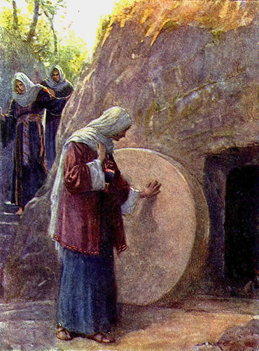
Resurrecting a Dead Faith
Attend Bible classes and worship.
Ephesians 4:11-16
Read and study on your own.
2 Timothy 2:15
Be doers, not just hearers.
James 1:21-25
Notes:
Resurrecting a Dead Faith.
Attend Bible classes and worship services regularly—Eph.4:11-16; Heb.10:24,25. Build your faith through the word and fellowship with other faithful brethren.
Read and study the Bible on your own. 2 Tim.2:15; 1 Pet.3:15. Putting God’s word in your heart will help resurrect a dead faith.
Be doers and not hearers only!— Jam.1:21-25. Believing some facts about God and knowing His word means nothing if one does not properly apply that word in his life!

Slide 12
Resurrecting a Dead Faith
Pray
1 Thessalonians 5:17
Strengthen what you have.
2 Peter 1:5-11
Serve
Romans 12:1,2; James 2:15-17
Notes:
Resurrecting a Dead Faith.
(4) Pray regularly—1 Thess.5:17; Phil.4:6. Build your faith by talking to and leaning on God.
(5) Strengthen what you have. 2 Pet.1:5-11; Rev.3:2,3. Begin where you are to do those things that are right and honorable—correct those that need work!
(6) Prepare to serve!— Rom.12:1,2; Jam.2:15-17. Make preparations to serve Him in every way possible. Make the commitment and then follow through with your choice.

Slide 13
Resurrecting a Dead Faith
“Examine yourselves as to whether you are in the faith. Test yourselves. Do you not know yourselves, that Jesus Christ is in you? --unless indeed you are disqualified.” {2 Corinthians 13:5}
Notes:
Let all bitterness—Πασα πικρια. It is astonishing that any who profess to be Christians should indulge in bitterness of spirit. Those who are censorious, who are unmerciful to the failings of others, who have a certain fixed standard by which they measure all persons in all circumstances, and unchristian every one who does not meet this standard, have the bitterness against which the apostle spoke. In the last century, there was a compound medicine, made up from a variety of drastic acrid drugs and ardent spirits, which was called Hiera Picra, ἱερα πικρα, the holy bitter; this medicine was administered in a multitude of cases, where it did immense evil, and perhaps in scarcely any case did it do good. It has ever appeared to me to furnish a proper epithet for the disposition mentioned above, the holy bitter; for the religiously censorious act under the pretense of superior sanctity. I have known such persons to do much evil in a Christian society, but never knew an instance of their doing any good.—Adam Clarke's Commentary

Slide 14
The Autopsy of a Dead
Faith
Why Perform Autopsies?
How Do the Living benefit From an Autopsy?
How Do You Resurrect a Dead Faith?
Notes:
Concluding Thoughts: The Autopsy of a Dead Faith…Review…Invitation

