Slide 1
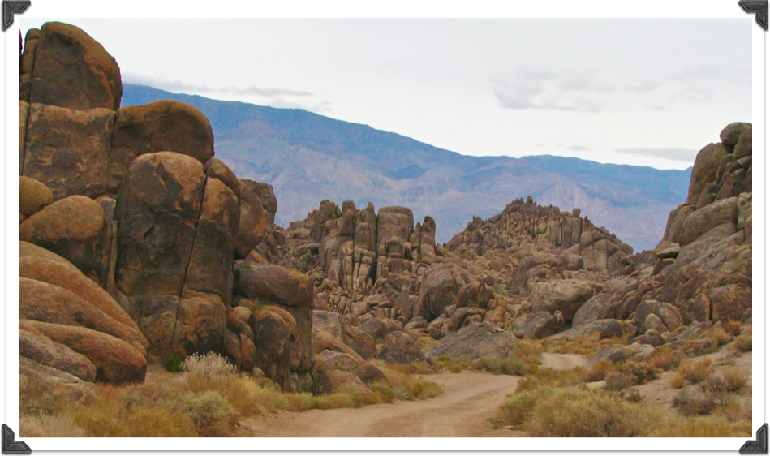
In the Valley of Despair
Notes:
Title Slide: In the Valley of Despair…

Slide 2
Despair
“To lose all hope; to be overcome by a sense of futility or defeat; complete loss of hope.”
“Now when neither sun nor stars appeared for many days, and no small tempest beat on us, all hope that we would be saved was finally given up.” {Acts 27:20}
Notes:
Defining our subject…Despair. Biblical example—Acts 27:20—when Paul was shipwrecked on his way to Rome. The crew had given up, thinking they and the ship would be lost at sea!

Slide 3
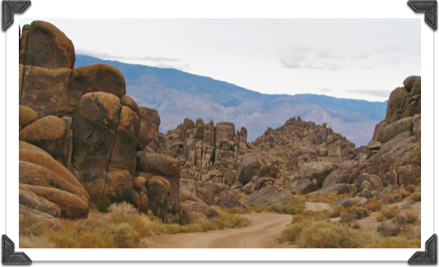
Despair Due to Horrible Circumstances Psalms 42 and 43
“Where’s Your God Now?”
Appetite-Killing Tears
Kept From Worship
Far From Home
Forgotten, Rejected
Oppressed
Unethical Enemies
Notes:
Despair Due to Horrible Circumstances…
“Where’s your God now?”
Appetite-killing tears
Kept from worship
Far from home
Forgotten, rejected
Oppressed
Unethical enemies.
It all seems like a bad dream or a nightmare. Every day seems to get worse, and you’re further from a solution. Been there?

Slide 4
Faithful Contemplation Like Abraham
“(as it is written, "I have made you a father of many nations") in the presence of Him whom he believed-God, who gives life to the dead and calls those things which do not exist as though they did; who, contrary to hope, in hope believed, so that he became the father of many nations, according to what was spoken, "So shall your descendants be.“ And not being weak in faith, he did not consider his own body, already dead (since he was about a hundred years old), and the deadness of Sarah's womb. He did not waver at the promise of God through unbelief, but was strengthened in faith, giving glory to God, and being fully convinced that what He had promised He was also able to perform. And therefore "it was accounted to him for righteousness.” {Romans 4:17-22}
Notes:
Faithful Contemplation Like Abraham…Rom.4:17-22. Abraham believed--even though he was 100 and Sarah was 90—that God would give him the son He had promised. Abraham’s faith did not waver; he believed God. Hope was not gone. Look at Heb.11:17-19 to see what was in Abraham’s mind.

Slide 5
Actions Leading out of the Valley of Despair
Longing for God.
“As the deer pants for the water brooks, So pants my soul for You, O God. My soul thirsts for God, for the living God. When shall I come and appear before God?” {Psalm 42:1,2}
Notes:
Actions Leading out of the Valley of Despair…
(1) Longing for God—Psa.42:1,2—knowing He can help.

Slide 6
Actions Leading out of the Valley of Despair
Remembering.
“When I remember these things, I pour out my soul within me. For I used to go with the multitude; I went with them to the house of God, with the voice of joy and praise, with a multitude that kept a pilgrim feast.” {Psalm 42:4}
Notes:
Actions Leading out of the Valley of Despair…
(2) Remembering—Psa.42:4—remembering the promises and help that God has promised should help in time of trouble…Past experiences.

Slide 7
Actions Leading out of the Valley of Despair
Hoping.
“Why are you cast down, O my soul? And why are you disquieted within me? Hope in God, for I shall yet praise Him For the help of His countenance.” {Psalm 42:5}
Notes:
Actions Leading Out of the Valley of Despair…
(3) Hoping—Psa.42:5—Christians should remember that with the Lord, there is always HOPE…

Slide 8
Actions Leading out of the Valley of Despair
Preparing to worship.
“Oh, send out Your light and Your truth! Let them lead me; let them bring me to Your holy hill and to Your tabernacle. Then I will go to the altar of God, to God my exceeding joy; and on the harp I will praise You, O God, my God.” {Psalm 43:3,4}
Notes:
Actions Leading out of the Valley of Despair…
(4) Preparing to Worship…Psa.43:3,4…True worship can encourage a person who is dealing with difficult circumstances. Knowing that our worship is being offered before God’s throne can lift up our spirits…

Slide 9
Actions Leading out of the Valley of Despair
Prayer and praise.
“The LORD will command His lovingkindness in the daytime, and in the night His song shall be with me-a prayer to the God of my life.” {Psalm 42:8}
Notes:
Actions Leading out of the Valley of Despair…
(5) Prayer and Praise…Psa.42:8…Talking with God can help lift one out of despair. Prayer is our communication line with our Father—we know He cares and is listening!

Slide 10
Actions Leading out of the Valley of Despair
Strengthening yourself.
“Why are you cast down, O my soul? And why are you disquieted within me? Hope in God; for I shall yet praise Him, the help of my countenance and my God.” {Psalm 43:5}
Notes:
Actions Leading out of the Valley of Despair…
(6) Strengthening yourself…Psa.43:5…One must put his faith and trust in God into practice. Where is our faith when we allow despair to overwhelm our lives? Trust that in the end, all will be well with your soul. Rom.8:28.

Slide 11
Actions Leading out of the Valley Suggestions From Hebrews
Longing for God.
“But without faith it is impossible to please Him, for he who comes to God must believe that He is, and that He is a rewarder of those who diligently seek Him.” {Hebrews 11:6}
Notes:
Actions Leading out of the Valley of Despair…
(1) Longing for God—Heb.11:6—

Slide 12
Actions Leading out of the Valley Suggestions From Hebrews
Remembering.
“But recall the former days in which, after you were illuminated, you endured a great struggle with sufferings: partly while you were made a spectacle both by reproaches and tribulations, and partly while you became companions of those who were so treated; for you had compassion on me in my chains, and joyfully accepted the plundering of your goods, knowing that you have a better and an enduring possession for yourselves in heaven. Therefore do not cast away your confidence, which has great reward.” {Hebrews 10:32-35}
Notes:
Actions Leading out of the Valley of Despair…
(2) Remembering—Heb.10:32-25—past experiences of the faithful!

Slide 13
Actions Leading out of the Valley Suggestions From Hebrews
Hoping.
“Thus God, determining to show more abundantly to the heirs of promise the immutability of His counsel, confirmed it by an oath, that by two immutable things, in which it is impossible for God to lie, we might have strong consolation, who have fled for refuge to lay hold of the hope set before us. This hope we have as an anchor of the soul, both sure and steadfast, and which enters the Presence behind the veil.” {Hebrews 6:17-19}
Notes:
Actions Leading out of the Valley of Despair…
(3) Hoping—Heb.6:17-19—

Slide 14
Actions Leading out of the Valley Suggestions From Hebrews
Preparing for worship.
“Let us hold fast the confession of our hope without wavering, for He who promised is faithful. And let us consider one another in order to stir up love and good works, not forsaking the assembling of ourselves together, as is the manner of some, but exhorting one another, and so much the more as you see the Day approaching.” {Hebrews 10:23-25}
Notes:
Actions Leading out of the Valley of Despair…
(4) Preparing for Worship—Heb.10:23-25—

Slide 15
Actions Leading out of the Valley Suggestions From Hebrews
Prayer and praise.
“Therefore by Him let us continually offer the sacrifice of praise to God, that is, the fruit of our lips, giving thanks to His name.” {Hebrews 13:15}
Notes:
Actions Leading out of the Valley of Despair…
(5) Prayer and praise—Heb.13:15—

Slide 16
Actions Leading out of the Valley Suggestions From Hebrews
Strengthening yourself and others.
“Beware, brethren, lest there be in any of you an evil heart of unbelief in departing from the living God; but exhort one another daily, while it is called "Today," lest any of you be hardened through the deceitfulness of sin.” {Hebrews 3:12,13}
Notes:
Actions Leading out of the Valley of Despair…
(6) Strengthening yourself and others—Heb.3:12,13—

Slide 17
Journeying Through the Valley
Help us long for the better country
“These all died in faith, not having received the promises, but having seen them afar off were assured of them, embraced them and confessed that they were strangers and pilgrims on the earth. For those who say such things declare plainly that they seek a homeland. And truly if they had called to mind that country from which they had come out, they would have had opportunity to return. But now they desire a better, that is, a heavenly country. Therefore God is not ashamed to be called their God, for He has prepared a city for them.” {Hebrews 11:13-16}
Notes:
Journeying Through the Valley…Help us long for the better country…Heb.11:13-16…Understanding this is just a temporal dwelling place. Our eternal home is somewhere else…Phil.3:20..

Slide 18
Journeying Through the Valley
Notes:
Close up view…

Slide 19
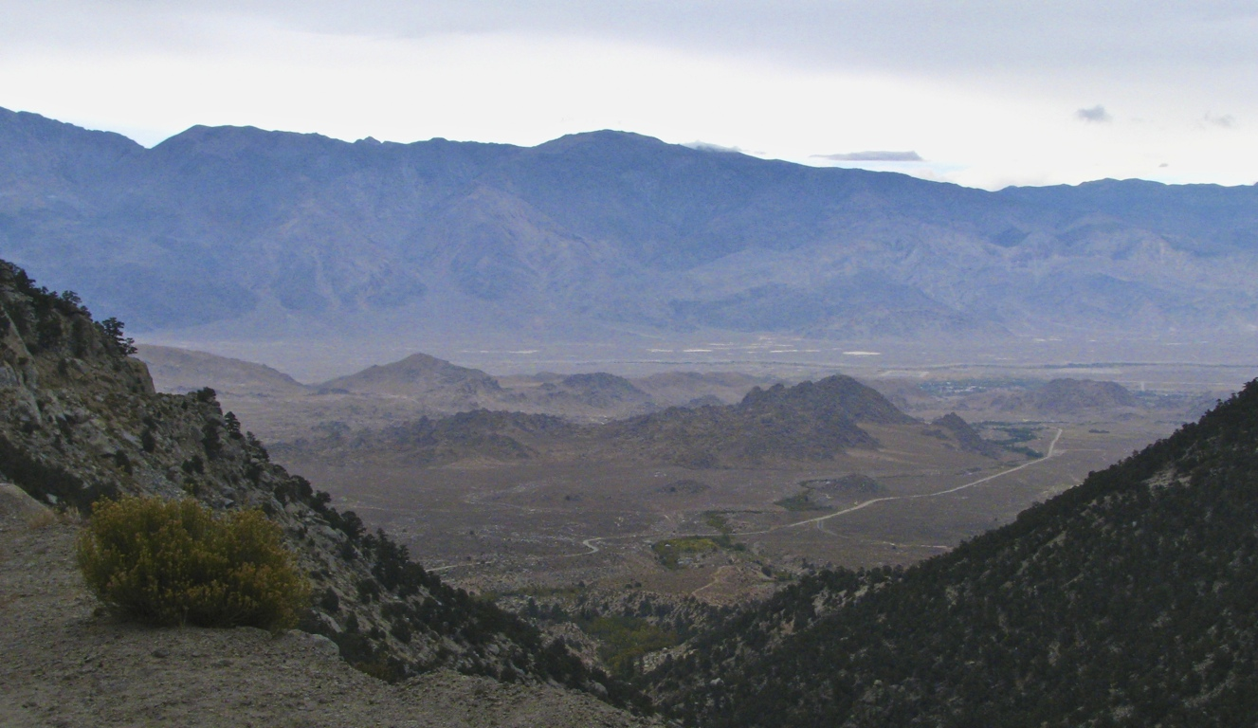
Journeying Through the Valley
Doesn’t seem like much from 6,000 feet.
What if viewed from Heaven?
You Were Here
Notes:
Summary--Invitation

