Slide 1
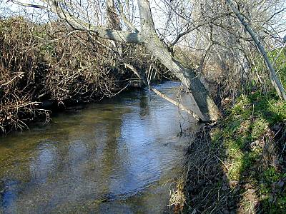
New Testament Survey: Book of Philippians
Outside of Philippi
Notes:
Title Slide: New Testament Survey: Book of Philippians…

Slide 2
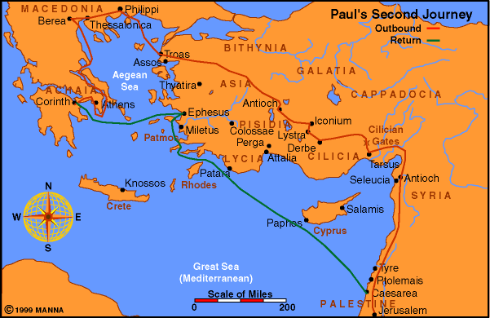
Notes:
Point out Philippi…

Slide 3
The City of Philippi
Its name came from its founder—Philip of Macedonia. It was a leading city (Acts 16:12)
Took pride in being a Roman colony—complaint against Paul (Acts 16:21-26)
Originally belonged to Thrace—seized by Alexander the Great
Has not been excavated and is presently uninhabited
Notes:
See page 79—Situated near a great highway through which traders from both east and west had to pass. A strategic center for preaching the gospel in Europe, well-watered and very close to some rich gold mines.

Slide 4
The Church at Philippi
Established by Paul on his second preaching journey—52 AD.
Holy Spirit forbade them to speak the word in Asia. (Acts 16:6-10)
Luke was with Paul, and they went to Troas.
Five days later, they left Neapolis and went up to Philippi.
God’s providence led Paul to Philippi.
Notes:
See page 79—These circumstances:
God’s intervention preventing Paul from speaking in Asia, Mysia, and Bithynia;
the vision at Troas;
a ship being immediately available;
a favorable wind on their journey…

Slide 5
The Church at Philippi
Not enough Jewish citizens to have a synagogue.
A meeting place for prayers outside the city—Paul found Lydia. (Acts 16:13)
Lydia and household first converts in Philippi.
Later, the jailer and his household converted. (Acts 16)
Church troubled by Judaizing teachers—largely Gentiles
Seem like Luke remained behind to assist the new church
Silas visited. (Acts 18:5)
Paul revisited twice and maintained close contact with these brethren. (Acts 20:6; 2 Corinthians 2:13)
Notes:
See page 80—

Slide 6
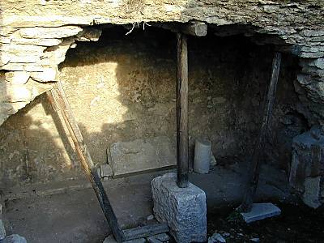
The Date
This is another of Paul’s prison epistles.
Overwhelming internal evidence that Paul wrote the letter while he was in Rome (first time).
Probably around 62 AD.
Notes:
See page 80—picture of jail in Philippi where Paul was with Silas…

Slide 7
Character and Purpose
Epaphroditus returned from Philippi to Rome to be of help to Paul.
The messenger fell sick at Rome and was near death—God’s mercy saved him. (2:25-30)
Notice Paul did not heal this messenger.
Confirms that miracles were never used for personal, private, or selfish reasons.
Notes:
See page 80—…

Slide 8
Character and Purpose
Epaphroditus longed to return home, and Paul knew the brethren were concerned about the sick messenger.
He sent this letter to express his gratitude for their concern for his needs while he was in prison.
Also to thank them for the aid they had sent to Paul by Epaphroditus.
Sincere thanks for their support from the “first day until now.” (1:3-5)
Notes:
See page 80—…

Slide 9
Contents of the Letter
Fellowship in evangelism
These brethren had partnered with Paul (had fellowship) by contributing to his daily needs.
1:3-5; 2:25; 4:14-18
This gives us an apostolic example of a church supporting a preacher.
This went on for more than 10 years.
Notes:
See page 81—from 2 Cor.11:7-9, we gain the additional information that they cooperated with other churches in supporting Paul at Corinth.

Slide 10
Contents of the Letter
Church support for gospel preacher:
Each church raised its own funds.
Each church chose the preacher it would support.
Each sent the money with its own messenger whom it chose and sent directly to the preacher.
No sponsoring church arrangement
The church in Philippi did not send to the church in Corinth—it sent directly to Paul!
Notes:
See page 81—from 2 Cor.11, we gain the additional information that they cooperated with other churches in supporting Paul while he was at Corinth.

Slide 11
Contents of the Letter
In 2 Corinthians 11:7-9, Paul said he received nothing from the church in Corinth.
For this reason, he continually thanked God for these brethren (1:3).
Here, we see a vibrant undertone of spiritual joy--”I rejoice; you rejoice.”
Common words throughout the letter—JOY and REJOICE
Paul learned contentment.
4:10-13
Notes:
See page 81— read 4:10-13…

Slide 12
Contents of the Letter
While in prison, Paul and Silas sang praises to God. (16:25)
Patient prisoner for the cause of Christ
Some had deserted him; he was suffering from his circumstances; literally in hunger and want; suffering from his opponents’ vile schemes; and facing the chopping block!
He could still rejoice! (4:4)
Notes:
See page 81,82—… this is the peace that passeth all understanding! (4:7)

Slide 13
Contents of the Letter
Why could Paul rejoice?
Bonds and affliction helped further the cause of the gospel. (1:12)
Christ was preached, even if in envy and strife. (1:15)
He accepted the sacrifice of his life because of the brethren’s love. (2:16-18)
Calm assurance the Lord was at hand. (4:5)
Received strength to preach the gospel because of their help. (4:14-17)
Notes:
See page 82—… this is the peace that passeth all understanding! (4:7)

Slide 14
Contents of the Letter
Self-sacrifice is the dominant chord in this letter of joy and thanksgiving.
Used the Lord as His example. (2:5,6)
Paul had showed the same commitment in his own life. (3:3-7)
He knew to die would be gain. (1:21-23)
Commendation of Timothy (2:19,20)
Used these brethren as examples to stir others to action. (2 Corinthians 8:7,8)
Extreme sacrifice—gave of their own accord! (2 Corinthians 8:1-3)
Notes:
See page 82—… this is the peace that passeth all understanding! (4:7)

Slide 15
Contents of the Letter
Characterized by some very strong exhortations expressed with love:
Unify to solve a personal disagreement. (4:2)
Exercise Christian unity by showing faithful obedience and diligence. (2:12-18)
Warns against the Judaizing teachers who would seek to destroy them. (3:1-3)
Keep their confidence in the Lord—do the things they had both “learned and received.” (4:4-9)
Notes:
See page 82—… this is the peace that passeth all understanding! (4:7)

