Slide 1
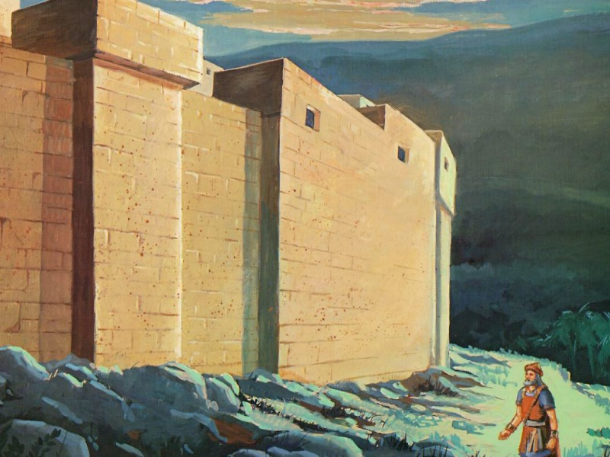
The Value of the Valley
Joshua 6
Notes:
Title Slide: The Value of the Valley…Joshua 6 . When we live in difficult and uncertain times, we may often wonder why bad things happen to good people. It causes us to wonder about our existence—why we’re here.
Consider Solomon—Eccl.2:1-3; 9-11. What if you had everything you ever wanted, no financial problems—would your life be a success? Solomon said NO! These things do not satisfy, and they will not endure. What would you put in your own autobiography?
Joshua 6—mountaintop of accomplishments.
Joshua 5:5-9—those born in the wilderness were circumcised and forgiven; they were
God’s people.
Joshua 5:10,11—they celebrated the Passover for first time in the Promised Land.
Joshua 5:13-16—angel of the Lord appeared to Joshua and told him that God would be with Israel.
Joshua 7:2-5—down in the valley of Ai. Not all of life’s lessons are learned on the mountaintops—some are learned in the valleys. Why? Could it be we might not appreciate the mountaintops if we didn’t have the valleys?
Joshua 7:11—”sin in the camp”;
Joshua 7:16-18—Joshua examined each man in each family.
Joshua 7:19—Achan was told to confess his sin?
Joshua 7:20-23—he confessed everything.
Joshua 7:24-26—Achan and his family paid a heavy price.

Slide 2
The Value of the Valley
Some lessons to be learned can only be learned in the valley.
Some visions to be seen can only be seen in the valley.
Some strengths to be gained can only be gained in the valley.
Notes:
The Value of the Valley…
Some lessons to be learned can only be learned in the valley.
Some visions to be seen can only be seen in the valley.
Some strengths to be gained can only be gained in the valley.

Slide 3
Some Lessons to Be Learned Can Only Be Learned in the Valley
The consequences of sin often bring suffering to others.
Joshua 7
Man is not sufficient unto himself.
Hosea 2:14,15
Materialism is folly.
Luke 12:15-20
Haggai 1:5-11
Notes:
Some Lessons to Be Learned Can Only Be Learned in the Valley.
The consequences of sin can bring suffering to others. 36 men lost their lives and the nation was brought low. (Joshua 7)
Valley of Achor (Hos.2:14,15). Israel was rebelling. In despair, embarrassment, punishment. Destroyed (Hos.4:6).
“Door of Hope”—Learned to depend on God! Where? Suffering in the valley of despair. Sadly, the lessons would lead them into captivity in Assyria and Babylon…
Folly of materialism. Achan was rich in his tent. Have we learned this lesson? Matt.6:33; Lk.12:15-20. Sometimes, lessons are forgotten—Hagg.1:5-11. The people returned from captivity but left the Lord’s house unfinished for 16 years. They built their own houses but left His in ruins. They did not have enough for their needs because they had forgotten God. They were so busy doing their own things, they forgot about God’s things. Sound familiar? Hopefully, we don’t need to lose everything before we learn this lesson.

Slide 4
Some Visions to Be Seen Can Only Be Seen in the Valley
Gideon saw a vision.
Joshua 6:11ff
The apostle John saw some visions.
Revelation 4, 7, 19, 20
John saw VICTORY in the valley.
Without vision, the people perish.
Proverbs 29:1
Notes:
Some Visions to Be Seen Can Only Be Seen in the Valley.
(1) Judges 6: Gideon was called by God (11ff). The Israelites had labored, but they lost everything; they cried to the Lord (6:1-6). Why were they in this valley (6:11-13)? Had their fathers taught them only the mountaintop experiences and omitted the valley lessons? Gideon thought he was the wrong man (6:14,15). But God promised to be with him (6:16). How? 300 men would go up against an innumerable company (7:13ff).
Gideon implemented God’s plan, and it worked! For tools they used trumpets, torches, and empty pitchers…In Gideon’s vision, he received courage to move forward.
(2) Prov.29:18—Without vision, the people perish.
(3) The apostle John saw some visions. God’s people were undergoing intense persecution from those who sought to destroy the Lord’s church. IN THE VALLEY, John saw:
Rev. 4—the throne scene;
Rev.7—144,000 people dressed in white robes;
Rev.19—the Son of God on a white horse ruling and reigning;
Rev.20—martyrs, ruling and reigning with Christ. John saw VICTORY while he was down in the valley, not on the mountaintop.

Slide 5
Some Visions to Be Seen Can Only Be Seen in the Valley
We need visions today!
Not angels or miracles
We need to be aware of the lost.
2 Corinthians 4:3,4
We need to recognize Satan’s power to deceive.
1 Peter 5:8
We need to see God’s power to save.
Romans 1:16
Notes:
Some Visions to Be Seen Can Only Be Seen in the Valley.
(1) We need visions today (not angels or miracles).
(2) We need to be aware of the lost and dying in sin—2 Cor.4:3,4.
(3) We need to recognize Satan’s power to deceive—1 Pet.5:8;
(3) We need to see God’s power to save—Rom.1:16.

Slide 6
Some Strengths to Be Gained Can Only Be Gained in the Valley
Judges 13-16
Samson forgot his vow to God
Gave in to lust and pride
Departed from God
Returned to God (16:28)
2 Corinthians 12—”thorn in the flesh”
2 Corinthians 4:7ff; 4:16; 11:23
Philippians 4:13
Romans 8:13-39
Notes:
Some Strengths to Be Gained Can Only Be Gained in the Valley.
Judges 13-16—Samson, the 13th judge.
Samson forgot his vow to God.
Gave in to lust and pride
Departed from God (Isa.59:1,2)
Returned to God (16:28)
2 Corinthians 12—”thorn in the flesh.”
2 Cor.4:7ff—lived to manifest Christ’s life, even in tribulation.
2 Cor.4:16—though the outward man was perishing, Paul did not lose heart.
2 Cor.11:23—suffered much for the cause of Christ; what did he learn?
Phil.4:13—I can do all things through Christ.
Rom.8:13-39—trouble cannot separate a man from God—unless he allows it to do so.

Slide 7
Conclusion
“Have you not known? Have you not heard? The everlasting God, the LORD, the Creator of the ends of the earth, neither faints nor is weary. His understanding is unsearchable. He gives power to the weak, and to those who have no might He increases strength. Even the youths shall faint and be weary, and the young men shall utterly fall, but those who wait on the LORD shall renew their strength; they shall mount up with wings like eagles, they shall run and not be weary, they shall walk and not faint.” {Isaiah 40:28-31}
Notes:
Conclusion—Invitation…

