Slide 2
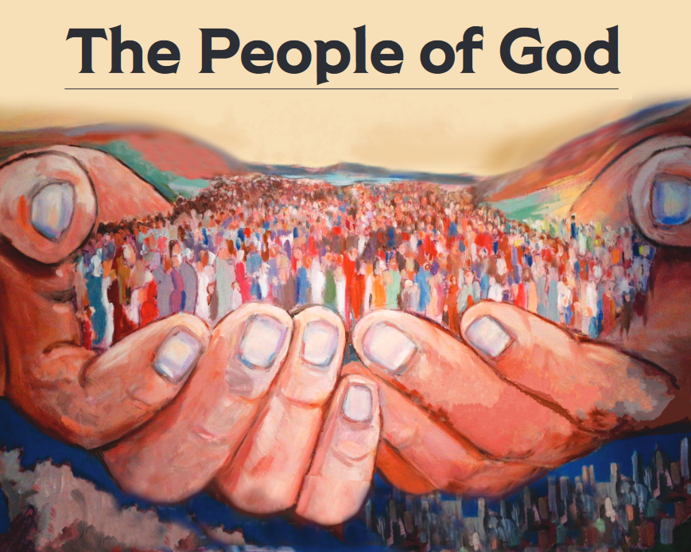
“But you are a chosen race, a royal priesthood, a holy nation, a people for God’s own possession, so that you may proclaim the excellencies of Him who has called you out of darkness into His marvelous light; for you once were not a people, but now you are the people of God.” (1 Peter 2:9-10)

Slide 3
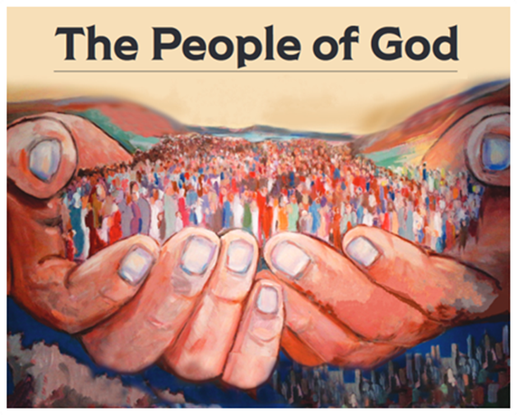
A Forward-Looking People
Philippians 3:12-14

Slide 4
4 Things Necessary In Order To Leave The Past Behind
I need to seek God’s forgiveness for my sins
Stop denying my sin
Turn away from sin
Confess my sin to God

Slide 5
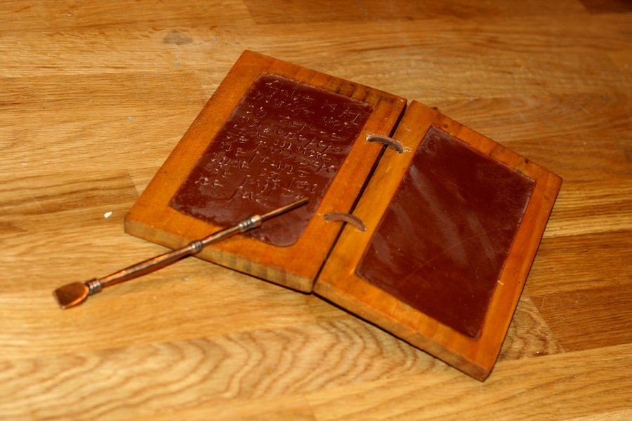
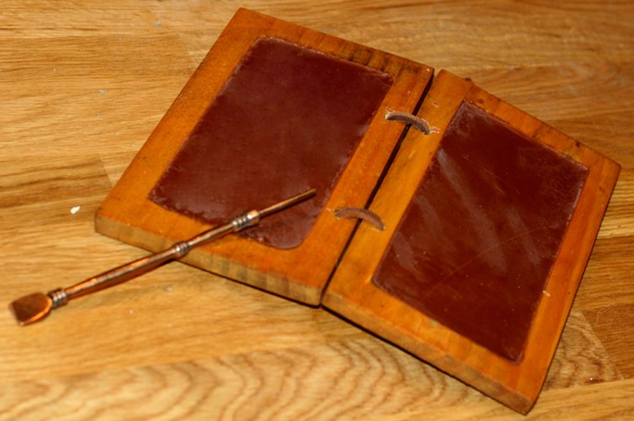
4 Things Necessary In Order To Leave The Past Behind
I need to seek God’s forgiveness for my sins
I need to realize just how much God wants to forgive me

Slide 6
4 Things Necessary In Order To Leave The Past Behind
I need to seek God’s forgiveness for my sins
I need to realize just how much God wants to forgive me
I need to accept my new identity in Christ
Helps me to see myself as God sees me: a saint

Slide 7
4 Things Necessary In Order To Leave The Past Behind
I need to seek God’s forgiveness for my sins
I need to realize just how much God wants to forgive me
I need to accept my new identity in Christ
I need to stand on the promises of God’s word
-Isa. 1:18
-Jer. 31:34
-Mic. 7:18-19

