Slide 2
Zechariah
“Behold, your King is coming to you.”

Slide 3
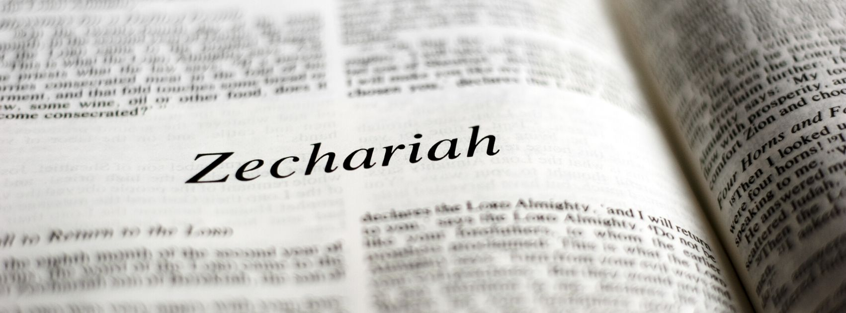
Most quoted Minor Prophet in the New Testament.
His images are a prominent part of the book of Revelation.
Gives us more specific Messianic Prophecies than any other Minor Prophet.

Slide 4
Contemporary of Haggai (Ezra 5:1).
Haggai focused on the shame of stopping work on the temple for selfish reasons.
Zechariah focused on the future. They needed to prepare for what was coming!

Slide 5
1. The Branch

Slide 6
1. The Branch
“There shall come forth a Rod from the stem of Jesse, and a Branch shall grow out of his roots.”
Isaiah 11:1

Slide 7
1. The Branch
“‘Behold, the days are coming,’ says the Lord, ‘that I will raise to David a Branch of righteousness; a King shall reign and prosper, and execute judgment and righteousness in the earth.’”
Jeremiah 23:5

Slide 8
1. The Branch
“Hear, O Joshua, the high priest, you and your companions who sit before you, for they are a wondrous sign; for behold, I am bringing forth My Servant the BRANCH.”
Zechariah 3:8

Slide 9
1. The Branch
“Then speak to him, saying, ‘Thus says the Lord of hosts, saying: “Behold, the Man whose name is the BRANCH…
Yes, He shall build the temple of the Lord. He shall bear the glory, and shall sit and rule on His throne; so He shall be a priest on His throne, and the counsel of peace shall be between them both.”’”
Zechariah 6:12-13

Slide 10
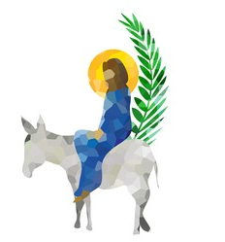
2. Your King is Coming to You
“Rejoice greatly, O daughter of Zion! Shout, O daughter of Jerusalem! Behold, your King is coming to you; He is just and having salvation, lowly and riding on a donkey, a colt, the foal of a donkey.
Zechariah 9:9

Slide 11
2. Your King is Coming to You
“Rejoice greatly, O daughter of Zion! Shout, O daughter of Jerusalem! Behold, your King is coming to you; He is just and having salvation, lowly and riding on a donkey, a colt, the foal of a donkey.
Zechariah 9:9
Matt. 21:4-5; John 12:14-16

Slide 12
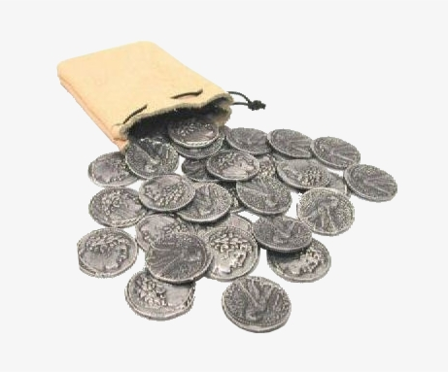
3. Thirty Pieces of Silver
Then I said to them, “If it is agreeable to you, give me my wages; and if not, refrain.” So they weighed out for my wages thirty pieces of silver.
And the Lord said to me, “Throw it to the potter” - that princely price they set on me. So I took the thirty pieces of silver and threw them into the house of the Lord for the potter.
Zechariah 11:12-13

Slide 13
3. Thirty Pieces of Silver
Then I said to them, “If it is agreeable to you, give me my wages; and if not, refrain.” So they weighed out for my wages thirty pieces of silver.
And the Lord said to me, “Throw it to the potter” - that princely price they set on me. So I took the thirty pieces of silver and threw them into the house of the Lord for the potter.
Zechariah 11:12-13
Matthew 27:3-10

Slide 14
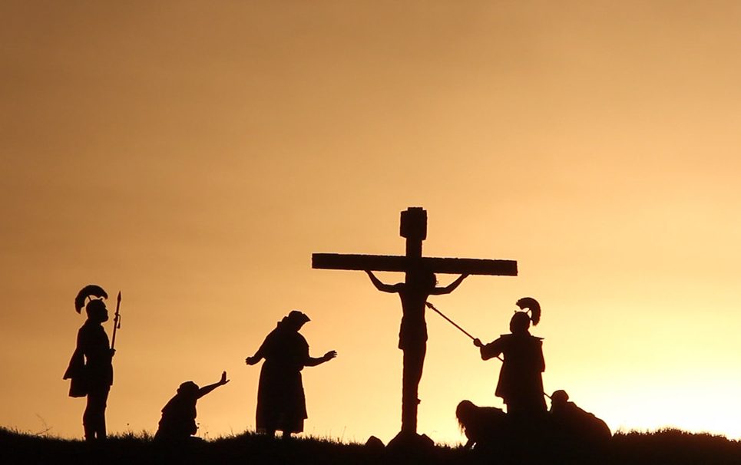
4. Look On the One They Pierced
“…Then they will look on Me whom they pierced. Yes, they will mourn for Him as one mourns for his only son, and grieve for Him as one grieves for a firstborn.”
Zechariah 12:10

Slide 15
4. Look On the One They Pierced
John 19:31-37
Revelation 1:7
John 12:32-33

Slide 16
5. Strike the Shepherd, Sheep Scatter
“‘Awake, O sword, against My Shepherd, against the Man who is My Companion,’ says the Lord of hosts. ‘Strike the Shepherd, and the sheep will be scattered…’”
Zechariah 13:7

Slide 17
5. Strike the Shepherd, Sheep Scatter
“‘Awake, O sword, against My Shepherd, against the Man who is My Companion,’ says the Lord of hosts. ‘Strike the Shepherd, and the sheep will be scattered…’”
Zechariah 13:7
Matthew 26:31, 56

Slide 18
Jesus was humble, betrayed by His own for 30 pieces of silver, abandoned by His supporters, and hung on a cross to die as a spectacle.
However, God’s Servant the Branch was exalted to sit and reign as King and Priest!

