Slide 2
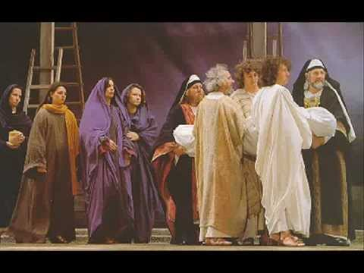
Joseph of Arimathea

Slide 3
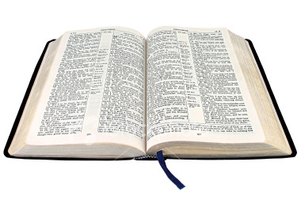
Joseph of Arimathea
Matthew 27:57-60
Mark 15:42-46
Luke 23:50-53
John 19:38-42

Slide 4
Secret Discipleship
Fear - John 19:38
Ashamed - Rom. 1:16; Mark 8:38
Love the World - John 12:42-43

Slide 5
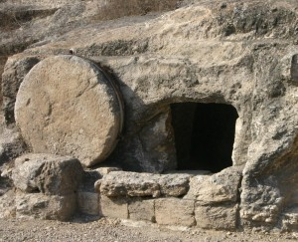
Good Lessons From Joseph of Arimathea
He did not go along with the majority
Luke 23:51
He overcame his fear
Mark 15:43
He was willing to pay a price
Luke 14:25-33

