Slide 1
Overcoming Is Necessary

Slide 2
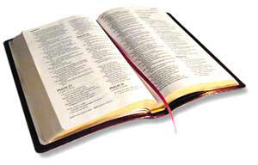
“My little children, these things I write to you, so that you may not sin. And if anyone sins, we have an Advocate with the Father, Jesus Christ the righteous.
And He Himself is the propitiation for our sins, and not for ours only but also for the whole world.”
1 John 2:1-2

Slide 3
“My little children, these things I write to you, so that you may not sin. And if anyone sins, we have an Advocate with the Father, Jesus Christ the righteous.
And He Himself is the propitiation for our sins, and not for ours only but also for the whole world.”
1 John 2:1-2

Slide 4
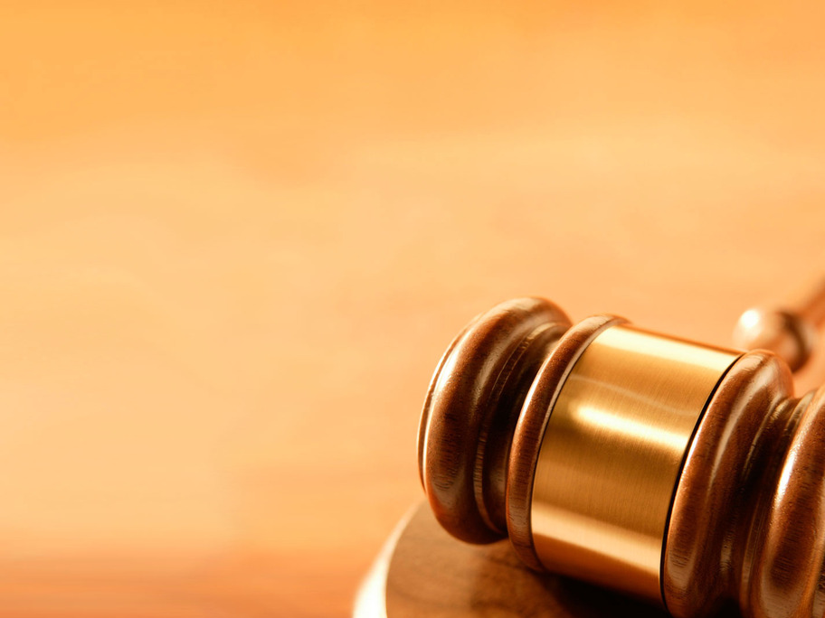
Advocate: a lawyer or attorney, one who pleads the case of another.
Propitiation: that which appeases or satisfies. Jesus’ death satisfies God’s law regarding the consequences of sin.

Slide 5
“My little children, these things I write to you, so that you may not sin. And if anyone sins, we have an Advocate with the Father, Jesus Christ the righteous.
And He Himself is the propitiation for our sins, and not for ours only but also for the whole world.”
1 John 2:1-2

Slide 6
Why Strive To Overcome Sin?
God Calls Us To Be Holy - 1 Pet. 1:13-19; 1 Thess. 4:3-7; 2 Cor. 7:1
Christians Are Dead To Sin - Rom. 6:1-2, 6, 11-13; Col. 3:3-9
We Are To Put Off the Old Man of Sin - Eph. 4:17-24; 1 Pet. 4:1-3
God’s Grace Teaches Us To Deny Ourselves - Titus 2:11-12; Rom. 6:15

Slide 7
Why Strive To Overcome Sin?
We Are Not To Allow Sin To Control Us - 1 Cor. 6:12; Gen. 4:7
God Provides A Way of Escape - 1 Cor. 10:13
Sin Has Temporal Consequences - Gal. 6:7-8
Continued Sin Results In Eternal Punishment - Heb. 10:26-31; 1 Cor. 9:25-27

