Slide 1
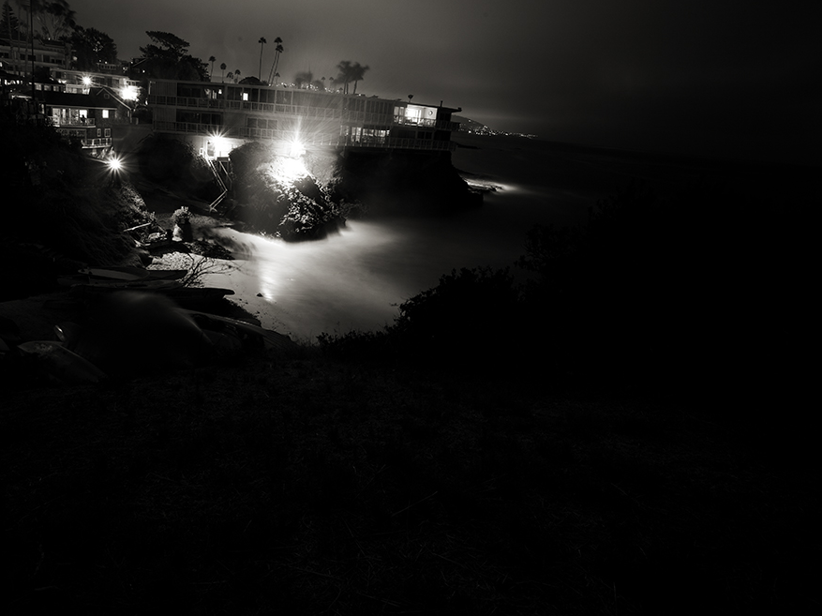
“Like a Thief in the Night”
1 Thessalonians 5:1-11

Slide 2
Certainty of the Lord’s Return
Jesus said He would return - John 14:1-3
Angels announced it - Acts 1:9-11
Subject of New Testament preaching and teaching - 1 Thess. 5:2; 2 Peter 3:4

Slide 3
The Nature of the Lord’s Return
He will actually come back - Acts 1:9-11
It will not be a secret - 1 Thess. 4:16; 2 Thess. 1:7-8
Time is unknown to man - Matt. 24:36
Cannot be stopped or avoided - 1 Thess. 5:3

Slide 4
What Happens When the Lord Returns
Resurrection of the Dead
1 Thess. 4:15-17; John 5:28-29
Bodies Changed
1 Cor. 15:42-44, 51-54
Earth Destroyed
2 Peter 3:10-13; Matt. 24:35
Judgment
Matt. 25:31-33, 46; Rev. 20:11-15

Slide 5
How Should We Respond To This?

Slide 6
How Should We Respond To This?
Should we speculate and invent theories concerning His Second Coming?
Should we look for signs and predict His return?
Should we stop working and await His imminent return?

Slide 7
How Should We Respond To This?
Realize the purpose for the descriptive phrase “as a thief in the night.”
1 Thess. 5:1-2
2 Peter 3:10
Matt. 24:42-44

Slide 8
How Should We Respond To This?
Realize the purpose for the descriptive phrase “as a thief in the night.”
1 Thess. 5:1-2
2 Peter 3:10
Matt. 24:42-44
No man can know when the Lord will return so we must be prepared (Matt. 24:45-51)!

Slide 9
“Are you ready?”
Judgment Day is coming - Heb. 9:27

Slide 10
“Are you ready?”
Judgment Day is coming - Heb. 9:27
Believe - John 8:24
Repent - Acts 17:30
Confess Christ - Rom. 10:9-10
Baptized - Mark 16:16
Live Faithfully - Rev. 2:10

