Slide 1
Dangers Facing the Church Today

Slide 2
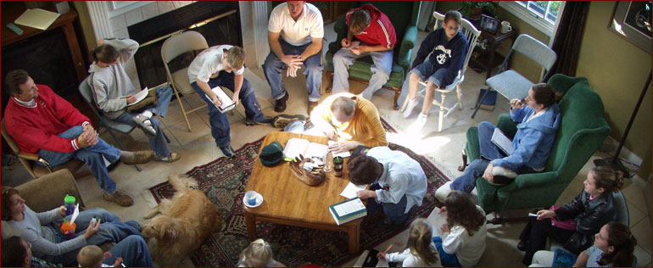
The House Church Movement

Slide 3
It is not unscriptural for a church to meet in a house.
Romans 16:5
1 Corinthians 16:19
Colossians 4:15
Philemon 2

Slide 4
The concern is regarding the agenda, beliefs, and practices of this movement and the impact that it is having upon an entire generation of members in the Lord’s church.

Slide 5
History of the HCM
Began among denominations.
Effort to break away from large, “tradition-ridden” assemblies.
Insisting that assemblies be small, informal, intimate, spontaneous, and mutually participatory.

Slide 6
Basic Beliefs of the HCM
Not every House Church has the same beliefs and practices.
However, there are some basic beliefs that are shared by those involved in this movement.

Slide 7
Basic Beliefs of the HCM
Smaller groups are essential for true worship and fellowship.
Stress that house churches are the pattern established for the church.
Limit the size of the church to the number of people who can eat a common meal together.
The Lord’s Supper is to be eaten as a full meal.

Slide 8
Basic Beliefs of the HCM
Practice unity in doctrinal diversity – stressing social relationships over doctrinal soundness.
Seek a casual atmosphere in dress and conduct.
Meetings are to be interactive, participatory, and open.

Slide 9
Basic Beliefs of the HCM
Mutual edification (no preacher).
No elders; reject any office or position of authority whereby any person has leadership over the other members.
No weekly contribution.

Slide 10
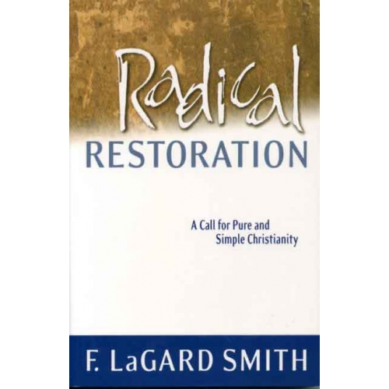
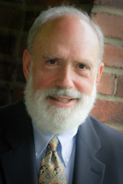
Brethren have been influenced by…

Slide 11
1. Attracts those who rebel against authority and despise tradition.

Slide 12
1. Attracts those who rebel against authority and despise tradition.
Elders are to exercise authority in the local church, and members are to submit to their authority.
Hebrews 13:17
1 Thessalonians 5:12-13

Slide 13
1. Attracts those who rebel against authority and despise tradition.
Paul called for Christians to be careful to follow the traditions that had been delivered to them.
1 Corinthians 11:2
2 Thessalonians 2:15, 3:6

Slide 14
2. Purposeful isolation from brethren

Slide 15
2. Purposeful isolation from brethren
“We have six families all in their 30’s who are committed to join this work.”

Slide 16
2. Purposeful isolation from brethren
God arranged the local church to be made up of different members with different levels of spiritual development.
Titus 2:1-6
1 Timothy 3:6

Slide 17
2. Purposeful isolation from brethren
In house churches, entire generations have purposefully separated themselves from a source of wisdom and experience that God has given to the local church for the benefit of the members, making them more vulnerable to error and apostasy.

Slide 18
3. Mutual Edification
The men take turns filling the pulpit.
All the members (including women) take turns speaking (testifying) in the worship assemblies.
The House Church Movement advocates the latter.

Slide 19
3. Mutual Edification
Disciples are to be taught, not just encouraged to discover truth on their own (Matt. 28:20).
Men are to be taught to teach others (2 Tim. 2:2).
God gave the local church evangelists, elders, and teachers for their edification (Eph. 4:11-12).

Slide 20
3. Mutual Edification
Assemblies are not to be spontaneous, but decent and orderly, and women are not allowed to address the assembly.
1 Corinthians 14:27-40

Slide 21
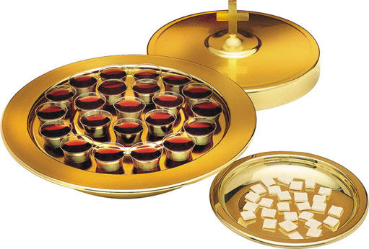
4. Perversion of the Lord’s Supper

Slide 22
4. Perversion of the Lord’s Supper
“The most universally-overlooked feature of the Lord’s Supper as practiced in the primitive church is that – from all appearance – it was observed in conjunction with a fellowship meal…”
“From its very inception, therefore, the Lord’s Supper was an integral part of a real meal…”

Slide 23
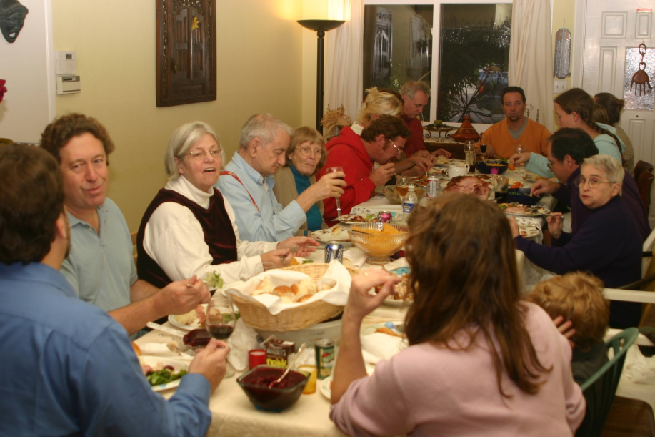
4. Perversion of the Lord’s Supper
“The Lord’s Supper gave meaning to their table fellowship, and their table fellowship gave meaning to the Lord’s Supper.”
Radical Restoration,
pp. 128-129, 133

Slide 24
4. Perversion of the Lord’s Supper
The Corinthians were rebuked for making the Lord’s Supper a common meal. (1 Cor. 11:17-26)
The Lord’s Supper is not a meal. It is a memorial (Luke 22:14-20).

Slide 25
The House Church Movement
Has the guise of being a noble and spiritual idea.
But it is contrary to the doctrine of Christ and the pattern for His church.
It is a clever vehicle by which a generation of Christians can rebel against authority and make themselves ripe for apostasy.

