Slide 1

“He Who Is Of God”
John 8:47,
“He who is of God hears God’s words; therefore you do not hear, because you are not of God.”
All Verses Are From The NKJV Unless Noted

Slide 2
44 "You are of your father the devil, and the desires of your father you want to do. He was a murderer from the beginning, and does not stand in the truth, because there is no truth in him. When he speaks a lie, he speaks from his own resources, for he is a liar and the father of it.
45 "But because I tell the truth, you do not believe Me.
46 "Which of you convicts Me of sin? And if I tell the truth, why do you not believe Me?
47 "He who is of God hears God’s words; therefore you do not hear, because you are not of God."
48 Then the Jews answered and said to Him, "Do we not say rightly that You are a Samaritan and have a demon?"
49 Jesus answered, "I do not have a demon; but I honor My Father, and you dishonor Me.
50 "And I do not seek My own glory; there is One who seeks and judges.
JOHN 8

Slide 3
Observations From The Text
Those Of The Devil:
Those Of God:
desire the Devil’s desire
use deceit
do not believe the truth
do not hear God’s word
dishonor Christ
desire God’s desire
operate in truth
believe truth
hear God’s word
glorify God and Christ

Slide 4
1. He Who Is Of God Hears
Hearing is the fundamental act for being saved
  “This you know, my beloved brethren. But let everyone be quick to hear, slow to speak and slow to anger” (Jas. 1:19)
  “Walk prudently when you go to the house of God; and draw near to hear rather than to give the sacrifice of fools, for they do not know that they do evil. Do not be rash with your mouth, And let not your heart utter anything hastily before God. For God is in heaven, and you on earth; Therefore let your words be few” (Eccl. 5:1-2)

Slide 5
2. He Who Is Of God Hears God’s Words
WHAT we hear is fundamentally important to our salvation
  We come together to hear God’s word!
  Is how faith is developed (Rom. 10:17)

Slide 6
WARNING: Hearing Is Not Enough!
“But be (1096) doers (4163) of the word, and not hearers only, deceiving yourselves” (Jas. 1:22; Matt. 7:24-27; Rom. 2:13)
  1096 - to become, to arise, be made
    Literally, “become ye doers of the word” (YLT)
    A progressive practice
    Same idea in Mark 10:16
    Be not the forgetful observer (Jas. 1:23-24)
    “Too often we leave the church or our study, and the impression produced by the recognition of the features of our own case is obliterated. ‘We straightway forget what manner of men we are,’ and the insight which has been granted to us into our own true selves is just one more wasted experience” (Expositor’s Bible Commentary)
  4163 – a maker, producer, author, doer, performer, poet (Acts 17:28)
“Little children, let no one deceive you. He who practices righteousness is righteous, just as He is righteous” (1 Jn. 3:7)
Notes:
Rom. 2:13, “for not the hearers of the law are just in the sight of God, but the doers of the law will be justified”
Mt 10:16 ¶ "Behold, I send you out as sheep in the midst of wolves. Therefore be wise as serpents and harmless as doves.
4163 from 4160 verb, 1) to make
1a) with the names of things made, to produce, construct, form, fashion, etc.
1b) to be the authors of, the cause
1c) to make ready, to prepare
1d) to produce, bear, shoot forth
1e) to acquire, to provide a thing for one’s self
1f) to make a thing out of something
1g) to (make i.e.) render one anything
1g1) to (make i.e.) constitute or appoint one anything, to appoint or ordain one that
1g2) to (make i.e.) declare one anything
1h) to put one forth, to lead him out
1i) to make one do something
1i1) cause one to
1j) to be the authors of a thing (to cause, bring about)
2) to do
2a) to act rightly, do well
2a1) to carry out, to execute
2b) to do a thing unto one
2b1) to do to one
2c) with designation of time: to pass, spend
2d) to celebrate, keep
2d1) to make ready, and so at the same time to institute, the celebration of the Passover
2e) to perform: to a promise
Hence it carries with it a wide array of activity from authoring something to shooting forth something. It seems that God wants us, like a poet, to acquire and celebrate the word by which we shoot forth and make something of ourselves from the word. Let us live God’s poem that when men read us they will see God.

Slide 7
2. He Who Is Of God Hears God’s Words
HOW we hear is fundamentally important to our salvation
  Spiritually Receptive, “He who has an ear, let him hear what the Spirit says to the churches” (Rev. 2:11a)
    Am I teachable?
    If I am not teachable, I am “NOT” of God
    Everyone has ears, but not everyone receives instruction

Slide 8

The Spiritually Receptive Ear
Is open and ready (Ps. 40:6; Acts 17:11)
Is welcoming (1 Thess. 2:13; Acts 8:31)
Seeks knowledge (Prov. 18:15)
Will hear rebuke
  “The ear that hears the rebukes of life will abide among the wise” (Prov. 15:31)
Can become afraid
  “O LORD, I have heard your speech and was afraid; O LORD, revive Your work in the midst of the years! In the midst of the years make it known; In wrath remember mercy” (Hab. 3:2)
Will keep/obey the message
  “But the ones that fell on the good ground are those who, having heard the word with a noble and good heart, keep it and bear fruit with patience” (Lk. 8:15)
Notes:
Psalm 40:6, “Sacrifice and offering You did not desire; My ears You have opened. Burnt offering and sin offering You did not require.”
Proverbs 18:15, “The heart of the prudent acquires knowledge, And the ear of the wise seeks knowledge.”

Slide 9
2. He Who Is Of God Hears God’s Words
THEREFORE
  He who is of God hears the apostles
    “We are of God. He who knows God hears us; he who is not of God does not hear us. By this we know the spirit of truth and the spirit of error” (1 Jn. 4:6)
    “He who receives you receives Me, and he who receives Me receives Him who sent Me” (Matt. 10:40)
    “If anyone thinks himself to be a prophet or spiritual, let him acknowledge that the things which I write to you are the commandments of the Lord” (1 Cor. 14:37)
    “And they continued steadfastly in the apostles’ doctrine…” (Acts 2:42)

Slide 10
2. He Who Is Of God Hears God’s Words
THEREFORE
  He who is of God hears the apostles
  He who is of God hears the truth
    The word is truth (Jn. 17:17)
    Our reaction to truth defines our reaction to Jesus “Jesus said to him, ‘I am the way, the truth, and the life. No one comes to the Father except through Me” (Jn. 14:6)

Slide 11

3. He Who Is Not Of God Does Not Hear
When he hates instruction
  Ps. 50:17, “But to the wicked God says: ‘What right have you to declare My statutes, Or take My covenant in your mouth, seeing you hate instruction and cast My words behind you?’”
  Pr 12:1 “Whoever loves instruction loves knowledge, But he who hates
  correction is stupid.”

Slide 12

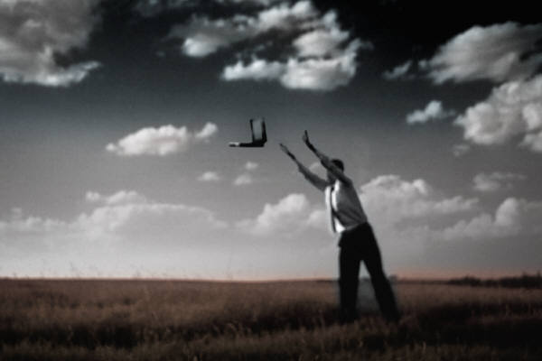
If I Really Hate My Computer

Slide 13


If I Really Hate God’s Word
Actually, all I have to do is:
  Refuse to read it
  Refuse to hear it
  Refuse to obey it
  Walk contrary to it
“…If anyone loves Me, he will keep My word…”
(Jn. 14:23)
Notes:
Ezekiel 20:16, “because they despised My judgments and did not walk in My statutes, but profaned My Sabbaths; for their heart went after their idols.”

Slide 14
3. He Who Is Not Of God Does Not Hear
When the word is held in derision
  Jer. 6:10, “To whom shall I speak and give warning, That they may hear? Indeed their ear is uncircumcised, And they cannot give heed. Behold, the word of the LORD is a reproach to them; They have no delight in it.”

Slide 15
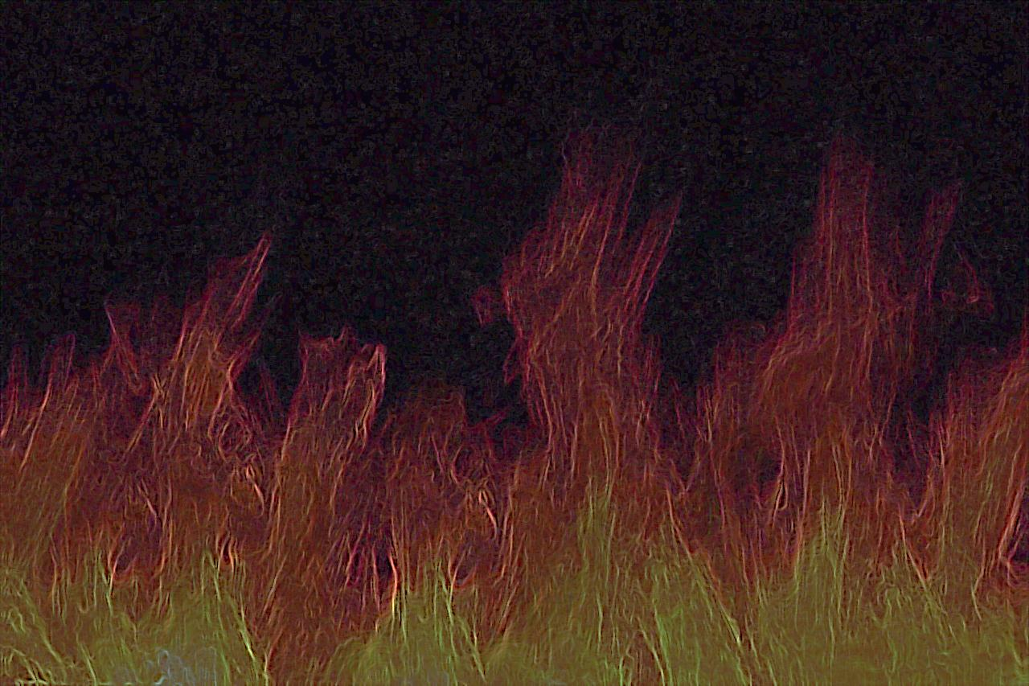
Jehoiakim, King Of Judah and Spiritual Pauper
Was not of God
  Cut up the scroll from Jeremiah and burned it (Jer. 36)
    Destroying the Bible will not erase its message
    Cutting down a “gospel sermon” will not make it false or irrelevant
    Cutting down the imperfections of the messenger will not make the word void

Slide 16
The Natural Man
Is Not of God
  “¹² Now we have received, not the spirit of the world, but the Spirit who is from God, that we might know the things that have been freely given to us by God. ¹³ These things we also speak, not in words which man’s wisdom teaches but which the Holy Spirit teaches, comparing spiritual things with spiritual. ¹⁴ But the natural man does not receive the things of the Spirit of God, for they are foolishness to him; nor can he know them, because they are spiritually discerned. ¹⁵ But he who is spiritual judges all things, yet he himself is rightly judged by no one. ¹⁶ For ‘who has known the mind of the LORD that he may instruct Him?’ But we have the mind of Christ” (1 Cor. 2:12-16)
Notes:
The natural man perceives things from a purely natural point of view. If he cannot see it, then it doesn’t matter and if it doesn’t have a natural benefit or pleasure to him then it is useless. The gospel, to the natural man, is a fool’s message. All the talk about righteousness, the resurrection and future judgment is nothing short of a fairy tale to him.

Slide 17
Acts 17:32, “And when they heard of the resurrection of the dead, some mocked, while others said, ‘We will hear you again on this matter.’”
Natural Man
Spiritual Man
Hears
Mocks
Hears
Wants More
What Group Are You In?

Slide 18
Self-Test
“Examine yourselves as to whether you are in the faith. Test yourselves. Do you not know yourselves, that Jesus Christ is in you? —unless indeed you are disqualified” (2 Cor. 13:15)

Slide 19
Self Test
“Do You Hear The Word that Says…”
Children obey your parents (Eph. 6:1-3)
Wives be submissive to your own husbands (1 Pet. 3:1)
Husbands love your wives just as Christ loved the church (Eph. 5:25)
If God so loved us, we also ought to love one another (1 Jn. 4:11)
Confess your trespasses to one another, and pray for one another (Jas. 5:16)
Serve one another (Gal. 5:13)
Admonish one another (Rom. 15:14)
Be submissive to one another (1 Pet. 5:5)
Be hospitable to one another (1 Pet. 4:9)
Be of one mind, having compassion for one another; love as brothers, be tenderhearted, be courteous (1 Pet. 3:8)
Do not speak evil of one another (Jas. 4:11)
Bear with one another, and forgiving one another (Col. 3:13)
Comfort each other and edify one another (1 Thess. 5:11)

Slide 20
Self Test
“Do You Hear The Word that Says…”
Jesus is the only way to the Father (Jn. 14:6)
Assembling with the saints is essential (Heb. 10:25)?
We must worship God in truth and spirit (Jn. 4:24)
Have no fellowship with the unfruitful works of darkness (Eph. 5:11)
We must seek first the kingdom of God and His righteousness (Matt. 6:33)
We have no right to call Jesus “Lord” if we do not obey Him (Lk. 6:46)
Jesus built one church (Matt. 16:18; Eph. 4:4; 1:22, 23)
We ought to obey God rather than man (Acts 5:29)
All have sinned and fallen short of the glory of God (Rom. 3:23)
The wages of sin is death (Rom. 6:23)
We must believe, confess, repent and be baptized to be saved (Mk. 16:16; Acts 2:37-41)

Slide 21
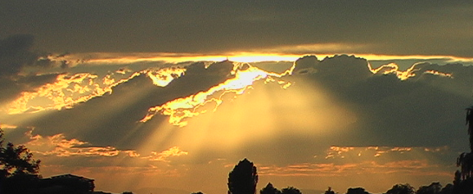
“He Who Is Of God Hears God’s Words”
Who Are You OF?
John 8:47,
“He who is of God hears God’s words; therefore you do not hear, because you are not of God.”

Slide 22
Hear Him Who Was Here!
“He who rejects Me, and does not receive My words, has that which judges him—the word that I have spoken will judge him in the last day” (Jn. 12:48)
“The queen of the South will rise up in the judgment with this generation and condemn it, for she came from the ends of the earth to hear the wisdom of Solomon; and indeed a greater than Solomon is here” (Matt. 12:42)

