Slide 1
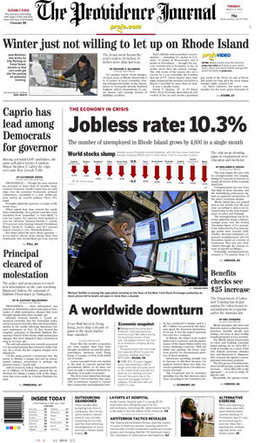
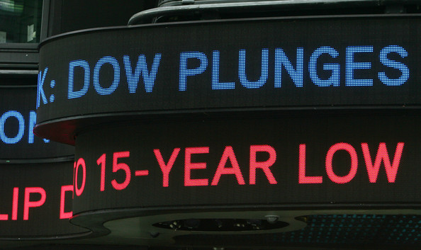
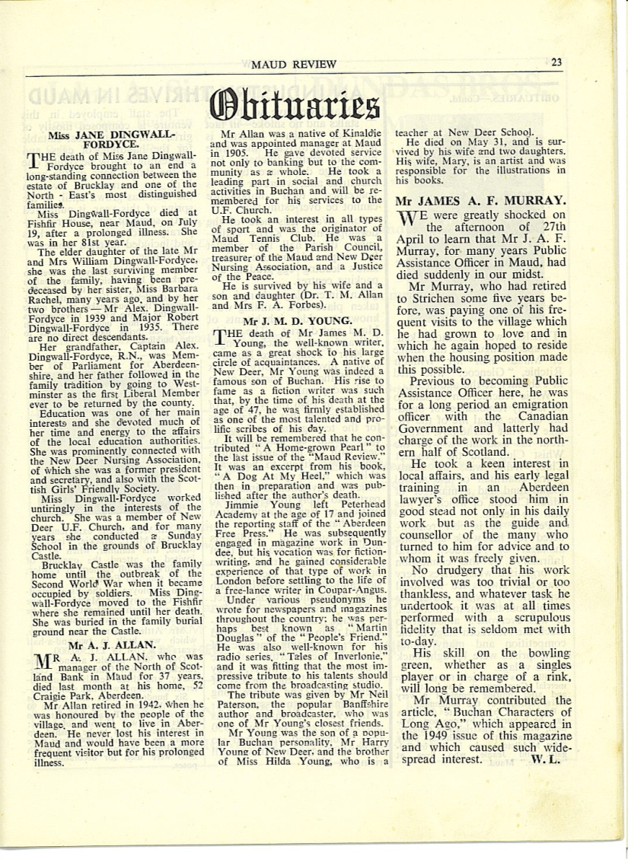
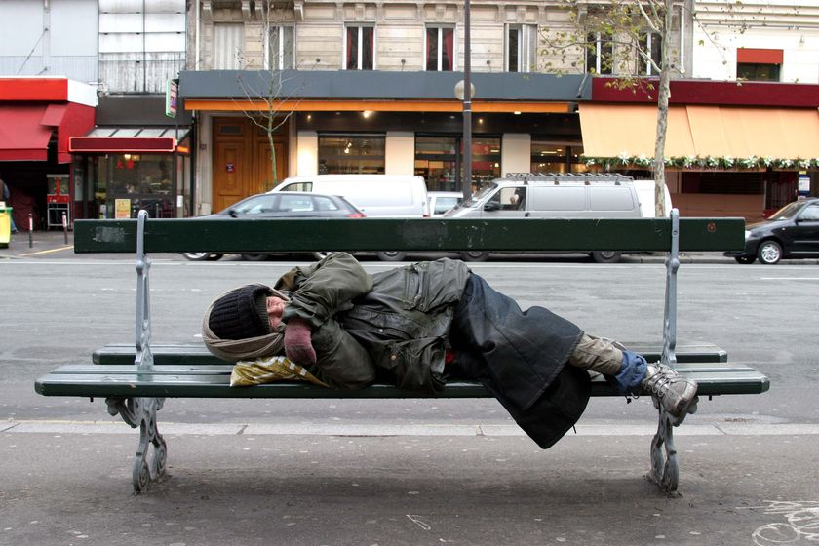
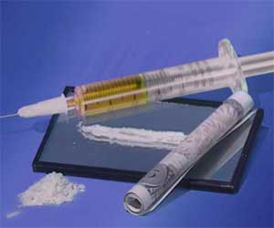
5
Notes:
Title Slide: We live in a world that is just chock full of problems that can get us down, discouraged and disillusioned, sometimes it appears…

Slide 2
Bad Things Happen to Good People
Good Things Happen to Bad People
The God of This World
In the Valley of Temptation
In the Valley of Death
In the Valley of Despair
The Plains of Compromise
Feeling Forsaken…
Notes:
Bad Things Happen To Good People! We are in…

Slide 3
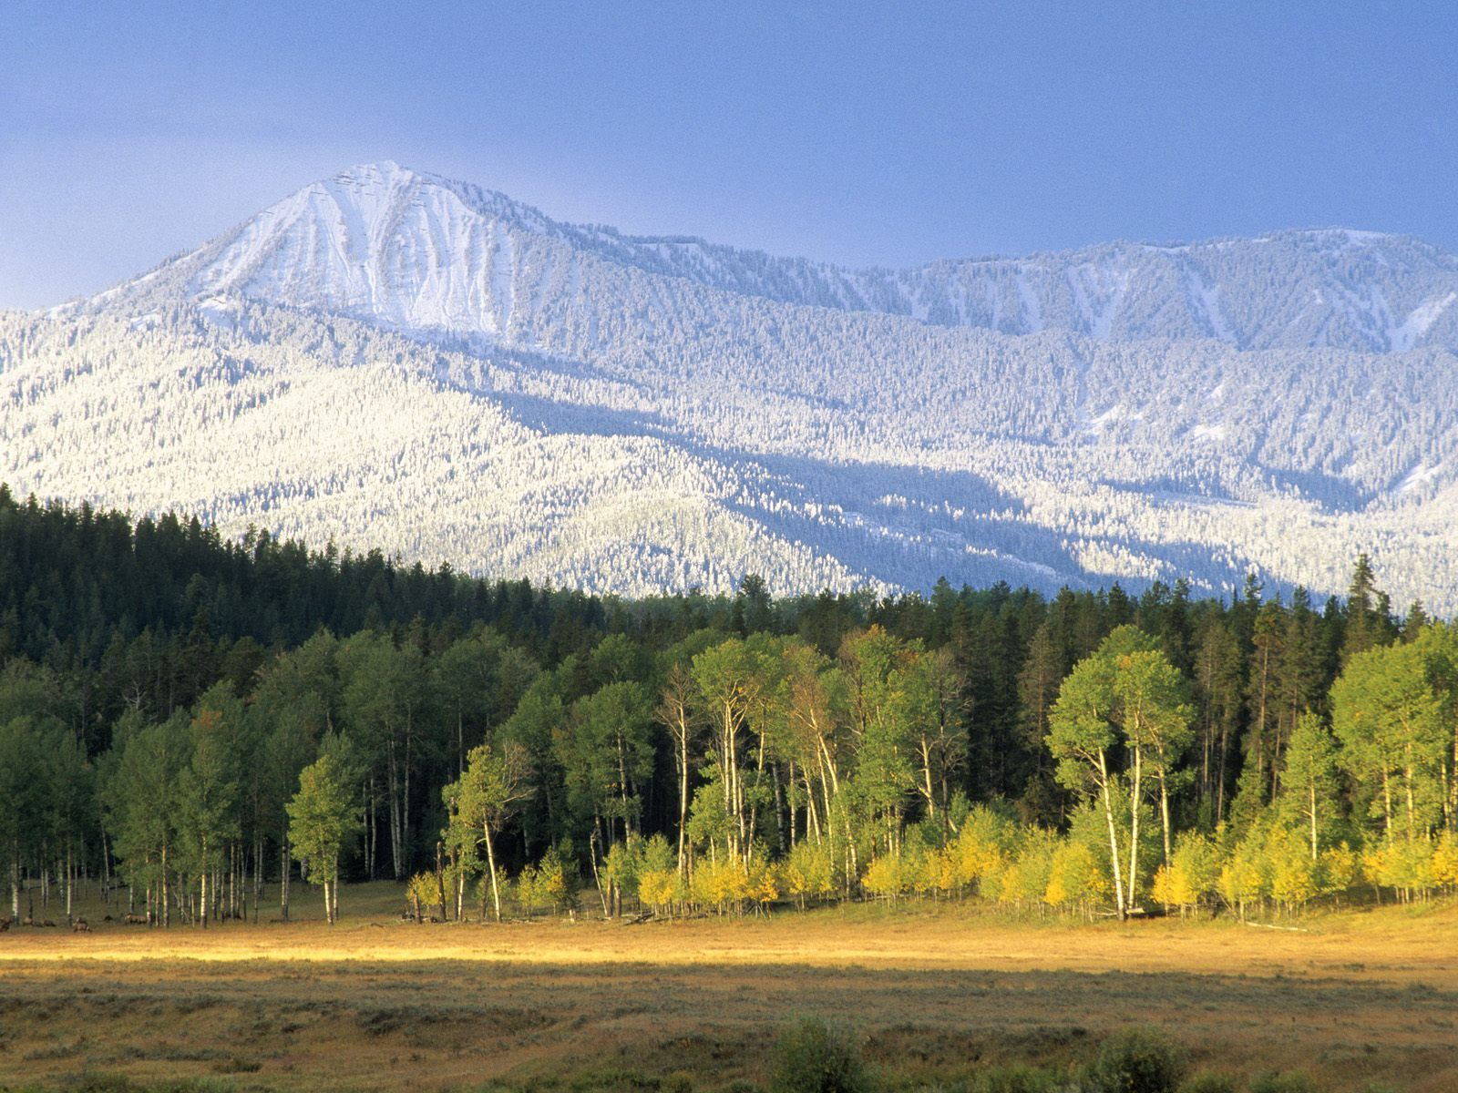
Mountaintop of Glory
Notes:
Title Slide: Mountaintop of Glory!

Slide 4
Hebrews 12:22-24
“But you have come to Mount Zion and to the city of the living God, the heavenly Jerusalem, to an innumerable company of angels, to the general assembly and church of the firstborn who are registered in heaven, to God the Judge of all, to the spirits of just men made perfect, to Jesus the Mediator of the new covenant, and to the blood of sprinkling that speaks better things than that of Abel.”
Notes:
Text…Heb.12:22-24…

Slide 5
Hebrews 12:25,26
“See that you do not refuse Him who speaks. For if they did not escape who refused Him who spoke on earth, much more shall we not escape if we turn away from Him who speaks from heaven, whose voice then shook the earth; but now He has promised, saying, ‘Yet once more I shake not only the earth, but also heaven.’”
Notes:
Text…Heb.12:25,26…

Slide 6
Hebrews 12:27,28
“Now this, ‘Yet once more,’ indicates the removal of those things that are being shaken, as of things that are made, that the things which cannot be shaken may remain. Therefore, since we are receiving a kingdom which cannot be shaken, let us have grace, by which we may serve God acceptably with reverence and godly fear.”
Notes:
Text…Heb.12:27,28…

Slide 7
1 Corinthians 15:24-28
“Then comes the end, when He delivers the kingdom to God the Father, when He puts an end to all rule and all authority and power. For He must reign till He has put all enemies under His feet. The last enemy that will be destroyed is death. For ‘He has put all things under His feet.’ But when He says ‘All things are put under Him,’ it is evident that He who put all things under Him is excepted. Now when all things are made subject to Him, then the Son Himself will also be subject to Him who put all things under Him, that God may be all in all.”
Notes:
Text…1 Cor.15:24-28… Also consider Col.1:13—”kingdom of His dear Son.”

Slide 8
Whatever life throws at us, we can stand victorious on the Mountaintop of Glory!
Notes:
Mountaintop of Glory!

Slide 9
“What then shall we say to these things? If God is for us, who can be against us?” {Romans 8:31}
Notes:
Mountaintop of Glory…Rom.8:31

Slide 10
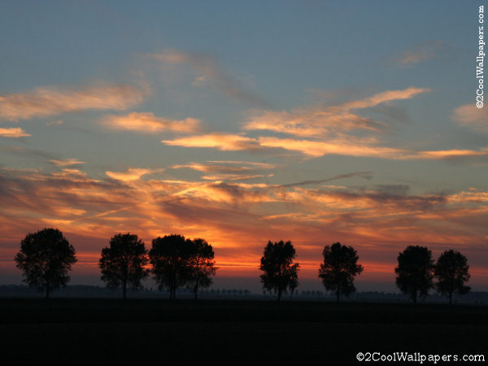
Tribulation
Distress
Nakedness
Famine
Sword
Persecution
Peril
Cannot separate us from the love of Christ – Romans 8:35
Notes:
Text—Romans 8:35-37…

Slide 11
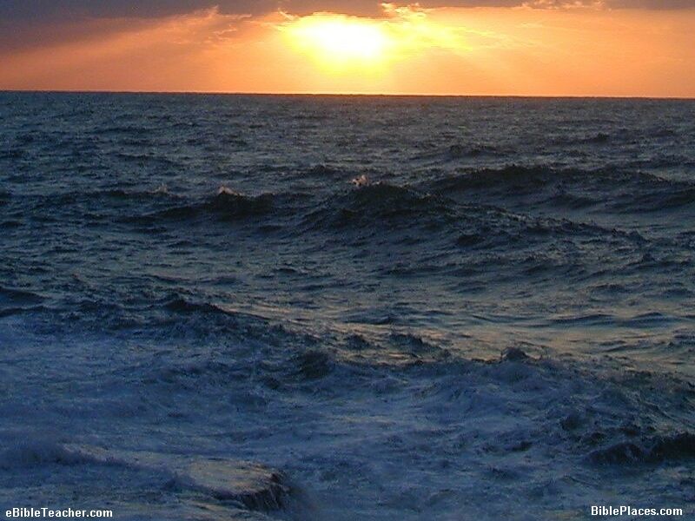
“For I am persuaded that neither death nor life, nor angels nor principalities nor powers, nor things present nor things to come, nor height nor depth, nor any other created thing…” {Romans 8:38,39}
Nothing is able to separate us from the love of God which is in Christ Jesus our Lord!
More Than Conquerors
Romans 8:26-39
Notes:
More Than Conquerors—Rom.8:26-39…

Slide 12
What does it mean to be more …
More Than Conquerors
Romans 8: 26-39
Notes:
More Than Conquerors—Rom.8:26-39…What Does it Mean????

Slide 13
“And not only that, but we also glory in tribulations, knowing that tribulation produces perseverance; and perseverance, character; and character, hope.” {Romans 5:3}
keep on conquering to a greater degree.
More Than Conquerors
Romans 8:26-39
Notes:
More Than Conquerors—Rom.8:5:3…We not only conquer in spite of them, we conquer all the more because of them! We allow them to strengthen us, mold us, and make us stronger!

Slide 14
“My brethren, count it all joy when you fall into various trials, knowing that the testing of your faith produces patience. But let patience have its perfect work, that you may be perfect and complete, lacking nothing.” {James 1:2-4}
Patience = Staying
Power
Testing = Proof
More Than Conquerors
Romans 8:26-39
Notes:
More Than Conquerors…Jam.1:2-4…Instead of allowing our trials to become obstacles, we let them help us build patience and endurance. Seeing a greater good accomplished.

Slide 15
“These things I have spoken to you, that in Me you may have peace. In the world you will have tribulation; but be of good cheer, I have overcome the world.” {John 16:33}
The world sees persecutors and oppressors as conquerors.
God views the oppressed and persecuted as conquerors.
Difference Between God’s Viewpoint and Man’s
Notes:
Difference Between God’s Viewpoint and Man’s…John 16:33…The world sees those who oppress us as conquerors—but God sees those who withstand the persecution and oppression as the conquerors. Do you see the difference? Instead of trials making us weaker—they make us stronger!

Slide 16
“So when this corruptible has put on incorruption, and this mortal has put on immortality, then shall be brought to pass the saying that is written: ‘Death is swallowed up in victory. O Death, where is your sting? O Hades, where is your victory?’ The sting of death is sin, and the strength of sin is the law. But thanks be to God, who gives us the victory through our Lord Jesus Christ.” {1 Corinthians 15:54-57}
In what way is the Christian victorious?
Notes:
In what way is the Christian victorious?…1 Cor.15:54-57…The Christian’s victory is assured by the Lord Himself! He has the keys to Death and Hades—Rev.1:18. He has given us the ability to avoid fearing death—Heb.2:15.

Slide 17
“Beloved, while I was very diligent to write to you concerning our common salvation, I found it necessary to write to you exhorting you to contend earnestly for the faith which was once for all delivered to the saints.” {Jude 3}
In what way is the Christian victorious?
“Then the word of God spread, and the number of the disciples multiplied greatly in Jerusalem, and a great many of the priests were obedient to the faith.” {Acts 6:7}
Notes:
In what way is the Christian victorious?…Jude 3; Acts 6:7…The Christian’s victory is assured by the Lord Himself! Just follow His instructions!

Slide 18
“Whoever believes that Jesus is the Christ is born of God, and everyone who loves Him who begot also loves him who is begotten of Him. By this we know that we love the children of God, when we love God and keep His commandments.” {1 John 5:1,2}
In what way is the Christian victorious?
“Who is he who overcomes the world, but he who believes that Jesus is the Son of God?” {1 John 5:5}
Notes:
In what way is the Christian victorious?…1 Jno.5:1,2,5…The Christian’s victory is assured by the Lord Himself! Just follow His instructions!

Slide 19
“And every spirit that does not confess that Jesus Christ has come in the flesh is not of God. And this is the spirit of the Antichrist, which you have heard was coming, and is now already in the world. You are of God, little children, and have overcome them, because He who is in you is greater than he who is in the world.” {1 John 4:3,4}
In what way is the Christian victorious?
Either overcome the world or be overcome by the world!
Notes:
In what way is the Christian victorious?…1 Jno.4:3,4…The choice is simple—we must OVERCOME the world’s attempts to destroy our faith—or we OVERCOME the world by our faith!

Slide 20
“Casting all your care upon Him, for He cares for you.” {1 Peter 5:7}
In what way is the Christian victorious?
“No temptation has overtaken you except such as is common to man; but God is faithful, who will not allow you to be tempted beyond what you are able, but with the temptation will also make the way of escape, that you may be able to bear it.” {1 Corinthians 10:13}
How can we claim VICTORY when at times it seems we are WORSE OFF than the most UNGODLY in the world?
Notes:
In what way is the Christian victorious?…1 Pet.5:7; 1 Cor.10:13. Psa.37:25—righteous never forsaken! Question sometimes pondered…

Slide 21
“For I considered all this in my heart, so that I could declare it all: that the righteous and the wise and their works are in the hand of God. People know neither love nor hatred by anything they see before them. All things come alike to all: One event happens to the righteous and the wicked; to the good, the clean, and the unclean; to him who sacrifices and him who does not sacrifice. As is the good, so is the sinner; he who takes an oath as he who fears an oath.” {Ecclesiastes 9:1,2}
In what way is the Christian victorious?
Ecclesiastes 2:1-11
“All is vanity and grasping after wind.”
Notes:
In what way is the Christian victorious?…Eccl.9:1,2—In the first 11 verses of Ecclesiastes 2, Solomon described what his advantages allowed him to do with his life. Taste and enjoy every earthly pleasure that could be bought, built, or personally enjoyed. Yet, in considering what it did for him, he arrived at the conclusion it was “vanity and grasping after wind.” Why? He forget God! There will be NO VICTORY if one forgets God and His ways!

Slide 22
“For our light affliction, which is but for a moment, is working for us a far more exceeding and eternal weight of glory, while we do not look at the things which are seen, but at the things which are not seen. For the things which are seen are temporary, but the things which are not seen are eternal.” {2 Corinthians 4:17,18}
What is this eternal weight of glory?
Notes:
What is this eternal weight of glory?…2 Cor.4:17,18—…

Slide 23
“For I consider that the sufferings of this present time are not worthy to be compared with the glory which shall be revealed in us.” {Romans 8:18}
What is this eternal weight of glory?
“But may the God of all grace, who called us to His eternal glory by Christ Jesus, after you have suffered a while, perfect, establish, strengthen, and settle you.” {1 Peter 5:10}
Notes:
What is this eternal weight of glory?…Rom.8:18; 1 Pet.5:10— Christ Himself called us to be partakers of this “eternal glory”!

Slide 24
Serves to:
Perfect—put all parts in right relation.
Establish—God keeping them firm.
Strengthen—God giving strength.
Settle—found on firm foundation.
The value of suffering.
Notes:
The value of suffering…serves to—Explain the chart…

Slide 25
With Little Loss—the dross gold loses in the furnace—a body on earth.
With Great Gain—glory, honor, peace, and an unfading crown of righteousness.
“In this you greatly rejoice, though now for a little while, if need be, you have been grieved by various trials, that the genuineness of your faith, being much more precious than gold that perishes, though it is tested by fire, may be found to praise, honor, and glory at the revelation of Jesus Christ.” {1 Peter 1:6,7}
More Than Conquerors
Romans 8:26-39
Notes:
More Than Conquerors…1 Pet.1:6,7…Instead of our trials becoming obstacles, we allow them to help us build patience and endurance. Seeing a greater good accomplished.

Slide 26
No external force can separate us from the love of God which is in Christ Jesus!
We can choose to separate ourselves when we turn a deaf ear to God and refuse to obey His will!
More Than Conquerors
Romans 8:26-39
Notes:
More Than Conquerors…2 Thess.1:7-9…No external force can separate us from the love of God which is in Christ Jesus! Yet, one choose to separate themselves by turning a deaf ear to God and refusing to Obey His will. Therefore, the separation from God cannot happen unless one allows life, circumstances and situation to turn their hearts away. Foolish to allow things that re “temporal” to cost us for all eternity!

Slide 27
There’s no true victory without Christ! With Christ, we can stand tall on the Mountaintop of Glory—declared to be MORE THAN CONQUERORS!
More Than Conquerors
Romans 8:26-39
Notes:
More Than Conquerors…John 14:6…Conclusion—Invitation…

