Slide 1
Why Does This Work?
Hear
Believe
Repent
Confess
Be Baptized
Does It Work?
Notes:
Title Slide: Why Does the Gospel Work?...Plan of Salvation—Does it Work???

Slide 2
Mark 16:15 “And He said to them, Go into all the world and preach the gospel to all creation.“
Notes:
Jesus sending the 12 into the world to preach—Great Commission…(Mark 16:15)

Slide 3
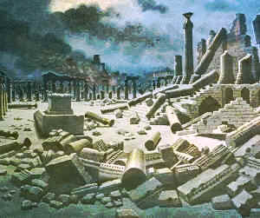
Matt. 24:14: “And this gospel of the kingdom will be preached in the whole world as a testimony to all nations, and then the end [Jerusalem’s destruction] will come.”
30 AD Jesus’ words
70 AD Jer. destroyed
+ 40 years to preach
Col.1:23: “…the hope of the gospel which you heard, which was preached to every creature under heaven, of which I, Paul, became a minister.”
63 AD
Notes:
Jesus predicts the destruction of Jerusalem. (Matt.24) {24:14}
Paul told the church at Colosse that the gospel had been preached—to the known world—(Col.1:23) 63 AD.

Slide 4
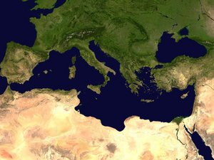
Where Paul would
spread the Gospel
Remember! The Lord personally
trained 12 other apostles.
Romans 15:20-24
“It has always been my ambition to preach the gospel where Christ was not known, so that I would not be building on someone else's foundation...But now that there is no more place for me to work in these regions, and since I have been longing for many years to see you, I plan to do so when I go to Spain…” .
3 missionary
journeys
1st Galatia
2nd Macedonia & Achaia
3rd Asia
Notes:
The Apostle Paul’s work in preaching the gospel…Rom.15:20-24. But remember 12 other apostles were also working in the world!

Slide 5
http://desip.igc.org/populationmaps.html
“The population of the world circa AD 1 has been considered to be between 200 and 300 million people. In that same period, the population of the early empire under Augustus has been placed at about 45 million. Using 300 million as the world benchmark, the population of the Empire under Augustus would've made up about 15% of the world's population. Of this 45 million people, Augustus declared within in his own census information that: * In 28 BC the citizen population was 4,063,000 (including both men and women) * In 8 BC - 4,233,000 * In AD 14 - 4,937,000
www.unrv.com
Notes:
World’s Population…www.unrv.com

Slide 6
2 Tim. 2:1-2: “You then, my son, be strong in the grace that is in Christ Jesus. And the things you have heard me say in the presence of many witnesses entrust to reliable men who will also be qualified to teach others.”
Consider this: If you led one person to the Lord every six months and spent the next six months instructing that person so they could produce more Christians, what do you think would happen?
Year | No. of Christians
1 | 2
2 | 4
8 | 256
16 | 65,536
20 | 1,048,576
33 | 8,589,934,592
Notes:
Making disciples…2 Tim.2:1,2… Each Christian teaches one, he teaches one, etc.

Slide 7
Why Does This Work?
“For the message of the cross is foolishness to those who are perishing, but to us who are being saved it is the power of God.” {1 Corinthians 1:18}
Hear
Believe
Repent
Confess
Be Baptized
Notes:
Why Does the Gospel Work?...Plan of Salvation—1 Cor.1:18…Foolishness to the world!

Slide 8
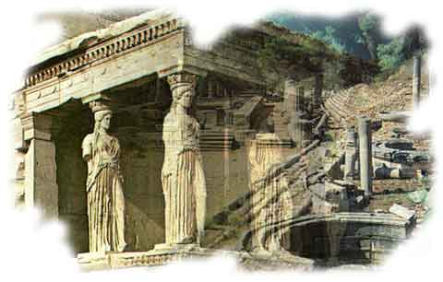
Corinth
“Do you not know that the unrighteous will not inherit the kingdom of God? Do not be deceived. Neither fornicators, nor idolaters, nor adulterers, nor homosexuals, nor sodomites, nor thieves, nor covetous, nor drunkards, nor revilers, nor extortioners will inherit the kingdom of God. And such were some of you. But you were washed, but you were sanctified, but you were justified in the name of the Lord Jesus and by the Spirit of our God.” 1 Corinthians 6:9-11

Slide 9
Why Does This Work?
Hear
Believe
Repent
Confess
Be Baptized
“For I am not ashamed of the gospel of Christ, for it is the power of God to salvation for everyone who believes, for the Jew first and also for the Greek.” {Romans 1:16}
Notes:
Why Does the Gospel Work?...Plan of salvation…Rom.1:16—It’s God’s POWER (dynamite) to save lost souls!

Slide 10
Why Does Preaching the Gospel Work?
Hearing | Destroys interest in sin
Believing | Destroys pleasure in sin
Repenting | Destroys practice of sin
Confessing | Destroys allegiance to sin
Being Baptized | Destroys the guilt of sin
Notes:
Why Does Preaching the Gospel Work? Destroys interest in Sin…loses its appeal. (Heb.11:23-25)

Slide 11
Why Does Preaching the Gospel Work?
Hearing | Destroys interest in sin
Believing | Destroys pleasure in sin
Repenting | Destroys practice of sin
Confessing | Destroys allegiance to sin
Being Baptized | Destroys the guilt of sin
Notes:
Why Does Preaching the Gospel Work? Destroys the pleasure of sin…Rom.6:23—understand the terrible cost!

Slide 12
What Believing (Conviction) Does
In convicting us of sin, God is
calling on us to recognize that
the change we must make is
not simply good advice; it is
an imperative. He is telling
us that what we have done
is not merely inconvenient,
counterproductive, or
undesirable; it is flat out wrong,
and we must change. Thus, conviction brings to change a
dimension that is otherwise lost.
Notes:
What TRUE Bible Conviction leads to…Discuss conviction (Acts 3:19)

Slide 13
Why Does Preaching the Gospel Work?
Hearing | Destroys interest in sin
Believing | Destroys pleasure in sin
Repenting | Destroys practice of sin
Confessing | Destroys allegiance to sin
Being Baptized | Destroys the guilt of sin
Notes:
Why Does Preaching the Gospel Work? Destroys practice of sin! Rom.6:16-18; Col.3:1,2.

Slide 14
Repentance
Which Does God Require?
“state of being penitent;
sorrow and contrition
for sin”
Webster
“to turn from sin and
dedicate oneself to the
amendment of one’s life”
Webster
Sin
Which Is Biblical Repentance?
Notes:
Repentance. Which Does God Require? Definitions of repentance…Which Is Biblical Repentance? (2 Cor.7:8-11)

Slide 15
Repentance: Two Primary Words
Metamelomai
meta melo
“change” “to care for”
Matthew 27:3
Acts 8:22
Metanoeo
meta nous
“change” “the mind”
Notes:
Repentance: Two Primary Words…Greek words…”meramelomai”—Change—to care for. “Metanoeo”—Change…the mind.

Slide 16
The Difference Between
Metamelomai and Metanoeo
“…literally to have a feeling or care, concern, or regret, it expresses the emotional aspect of repentance” (ISBE,IV,p.2558)
“…The term signifies ‘to have
another mind,’ to change the
opinion or purpose with regard
to sin. It is the equivalent to the
OT word “turn” (ISBE,IV,p.2558)
Sin
"In remorse [metamelomai] a man sees the bitter end of sin,
In repentence [metanoeo] he breaks free from it" (TDNT).
Notes:
Explain the difference…Difference between Judas and Peter…

Slide 17
2 Corinthians 7:10
There is a…
Sorrow according to the will of God
Repentance without regret
Sorrow of the world
“For the sorrow that is according to the will of God produces a repentance without regret, leading to salvation; but the sorrow of the world produces death.”
Notes:
Explaining 2 Cor.7:10…

Slide 18
Sorrow of the World?
It is the grief of the criminal mind:
Cain…anger, self-pity. Grieves over losses, not actions.
Pharaoh…Fleeting grief; seeks compromise.
King Saul…Seeks reconciliation on grief alone.
Young ruler—Grief over self-deception.
Judas—Grief over unexpected results; the mere desire that what he had done may be undone.
Notes:
Sorrow of the World.
It is the grief of the criminal mind:
Cain...Gen.4:3-7
Pharaoh (Exodus 5-11)
King Saul…(1 Samuel 28)
Young ruler—grief over self deception—Matt.19:22.
Judas—(Matt.27:1-5)

Slide 19
2 Corinthians 7:9,11
“Now I rejoice, not that you were made sorry, but that your sorrow led to repentance. For you were made sorry in a godly manner, that you might suffer loss from us in nothing... For observe this very thing, that you sorrowed in a godly manner: What diligence it produced in you, what clearing of yourselves, what indignation, what fear, what vehement desire, what zeal, what vindication! In all things you proved yourselves to be clear in this matter.”
Three Elements of Biblical Repentance
Emotion
Change of feeling
Intellect
Change of mind
Volition
Change of conduct
Notes:
Explaining 2 Cor.7:10…

Slide 20
When Is Repentance Complete?
Eph. 4:29
“…but only such a word
as is good for edification… give grace to those who hear”
For the
liar?
Eph. 4:25
“speak
truth”
For the
thief?
Eph. 4:28
“steal
no longer”
Eph. 4:28
“but labor…to share
w/him who has need”
Heb. 10:25
“not forsaking
our own
assembling”
Heb. 10:24-25
“consider how to
stimulate/encourage
one another”
For the
willfully
absent
Notes:
Discuss… WHEN is Repentance COMPLETE? (explain the chart…)

Slide 21
Why Does Preaching the Gospel Work?
Hearing | Destroys interest in sin
Believing | Destroys pleasure in sin
Repenting | Destroys practice of sin
Confessing | Destroys allegiance to sin
Being Baptized | Destroys the guilt of sin
Notes:
Why Does Preaching the Gospel Work? Destroys allegiance to sin…

Slide 22
1 Peter 3:21
“There is also an antitype which now saves us--baptism (not the removal of the filth of the flesh, but the answer of a good conscience toward God), through the resurrection of Jesus Christ.”
Thayer: “1.an inquiry, a question…3. the word thus gets the signification of earnest seeking; i.e., a craving, an intense desire…to long for something…pg.230
“Now when they heard this, they were cut to the heart, and said to Peter and the rest of the apostles, ‘Men and brethren, what shall we do?’” {Acts 2:37}
Notes:
Explaining 1 Pet. 3:21… Thayer defines the action of the penitent heart…Example of the question of those on Pentecost following the preaching of the gospel—Acts 2:37—answer in Acts 2:38—”repent and be baptized!” Also see Acts 22:8,10 and answer in 16!

Slide 23
Psalm 51:12-13
“Restore to me the joy of Thy salvation, and sustain me with a willing spirit. Then I will teach transgressors Thy ways, and sinners will be converted to Thee. “
Notes:
Psa.51:12,13…David’s attitude after being confronted by the prophet Nathan following his sin with Bathsheba. Teach others from his own mistakes! Contrite heart.

Slide 24
Why Does Preaching the Gospel Work?
Hearing | Destroys interest in sin
Believing | Destroys pleasure in sin
Repenting | Destroys practice of sin
Confessing | Destroys allegiance to sin
Being Baptized | Destroys the guilt of sin
Go,
make disciples
of all nations
Notes:
Why Does Preaching the Gospel Work? Destroys the guilt of sin…Now what do we do—GO MAKE DISCIPLES OF ALL NATIONS!

Slide 25
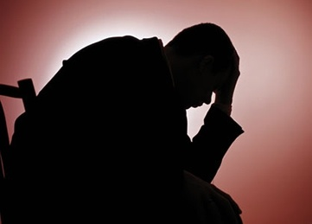
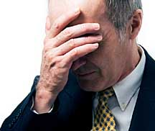
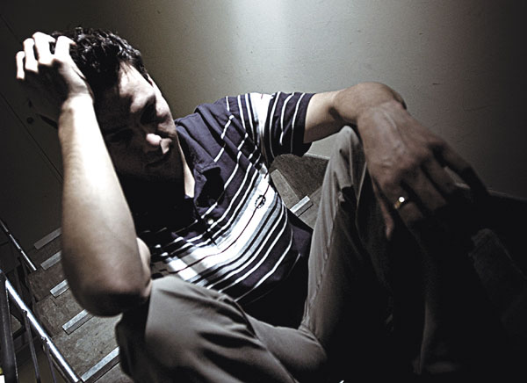
Struggling With Guilt?
Notes:
Men cannot find release from the guilt of sin without Christ and His blood shed on the cross. Rom.5:8,9.

Slide 26
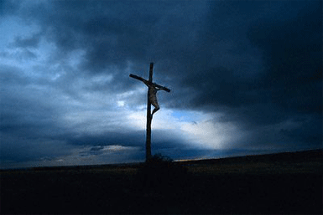
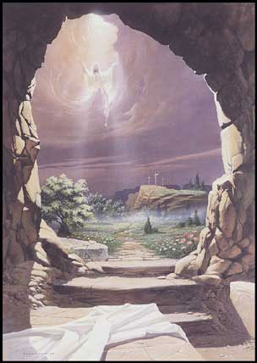
2 Corinthians 5:15
“He died for all,
that they who live should no
longer live for themselves,
but for Him who died and rose again on their behalf. “
Notes:
The Cross and the Open Tomb…2 Cor.5:15…Only real hope is in Christ, and that message is in the gospel!

Slide 27
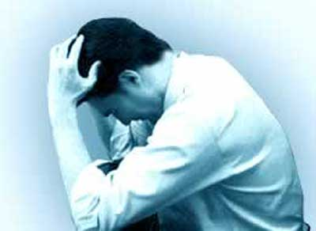
“I don’t know who I am anymore. I am so scared…
I do what I know is wrong. I have tried to stop – really,
I have. I have cried and sobbed at night. I have prayed and kept journals. I have read books. I am honestly at a loss. I love God,
but I cannot continue to ask for
forgiveness over and over and over for
the same thing. I know I need help, but
but I don’t know how to get it. I know
God has so much more planned for my
life than this. But this sin continues to
conquer me.”
3 Reasons
for Failure
Wrong…
motive
standard
source of
strength
Notes:
Summary and Invitation…

